Slide 2
Session 4: PPE and Plant Safety

Slide 3
Session Four Objectives
When trainees have completed this session, they should be able to do the following:
Identify and describe the proper use of personal protective equipment (PPE).
  Identify and describe the basic use of PPE used to protect workers from bodily injury.
  Identify potential respiratory hazards and the basic respirators used to protect workers against those hazards.

Slide 4
Session Four Objectives
When trainees have completed this session, they should be able to do the following:
Identify and describe other specific job-site safety hazards.
  Identify various exposure hazards commonly found on job sites.
  Identify hazards associated with environmental extremes.
  Identify hazards associated with hot work.
  Identify fire hazards and describe basic firefighting procedures.
  Identify confined spaces and describe the related safety considerations.

Slide 5
Session Four Performance Tasks
Properly don, fit, and remove the following PPE items:
Eye protection
Hearing protection
Hard hat
Gloves
Fall arrest harness
Inspect a typical power cord and GFCI to ensure their serviceability.

Slide 6
Section 5.1.0 – PPE
THE MOST COMMON PPE
Hard hats
Eye protection
Gloves
Safety footwear
Hearing protection
Respiratory protection
High-visibility clothing
Notes:
Discuss the importance of wearing the required PPE at all times. Point out that some companies take strong disciplinary action against someone violating PPE rules and that it may even be grounds for immediate dismissal. Explain that PPE must be properly cared for, properly worn, regularly inspected, and never altered.

Slide 7
Section 5.1.0 – PPE
WARNING!
Do not wear clothing or jewelry that could get caught in machinery or otherwise cause an incident, such as loose clothing, baggy shirts, or dragging pants. You must wear a shirt at all times; some tasks will require long-sleeved shirts. Your shirt should always be tucked in
unless you are performing welding.

Slide 8
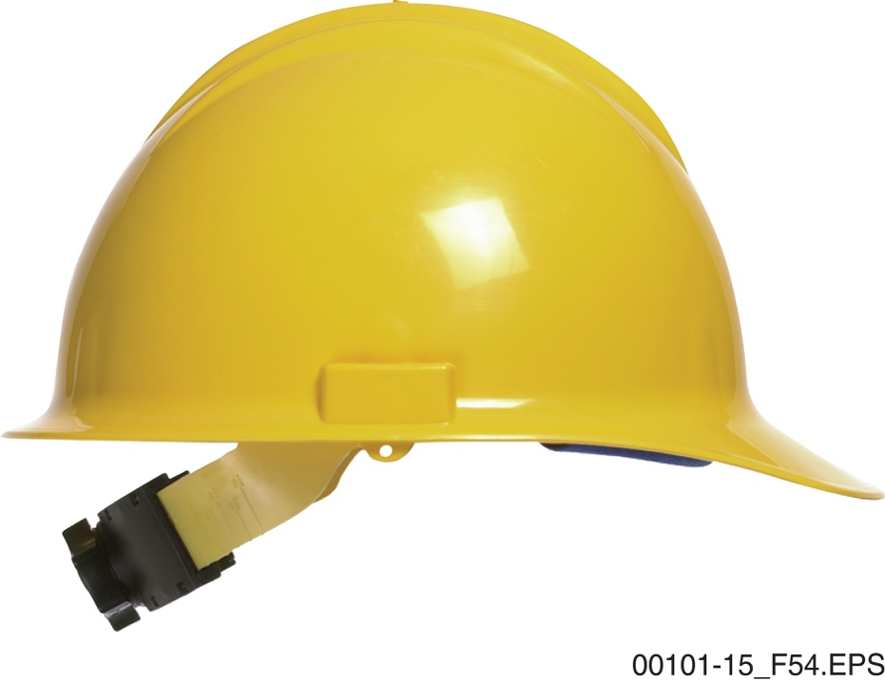
Section 5.1.1 – PPE
WARNING!
No articles should be worn under the hard hat that interferes with fit and visibility. That includes ball caps or hoodies that obscure peripheral vision. Only employer-approved gear
is to be worn under the hard hat.
Notes:
Provide hard hats for the trainees to examine. Point out the outer shell, webbing, and adjustment and explain the proper way to wear the hat. Discuss the importance of inspecting the hard hat and keeping it clean.

Slide 9

Section 5.1.2 – PPE
Some sort of eye protection is required at all times on a job site, regardless of the activity.
Notes:
Discuss the different types of eye and face protection and provide examples for the trainees to examine.

Slide 10
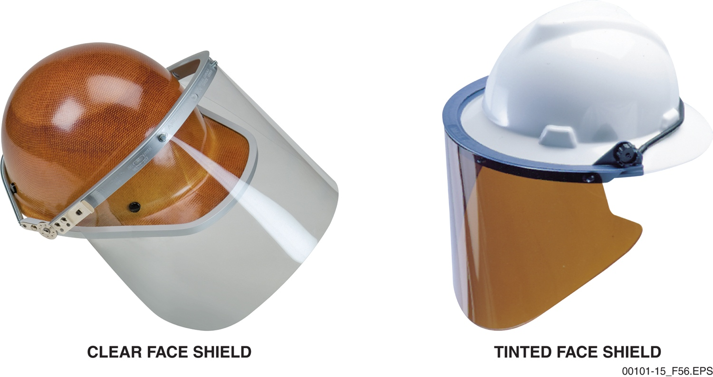
Section 5.1.2 – PPE
Face shields are required for grinding, chipping, sand blasting, and similar operations involving flying particles. They are normally required when working with chemicals as well.
Notes:
Describe the situations in which full face protection is required. Point out that special tinted goggles are required for anyone performing or working in proximity to welding or flame cutting.

Slide 11
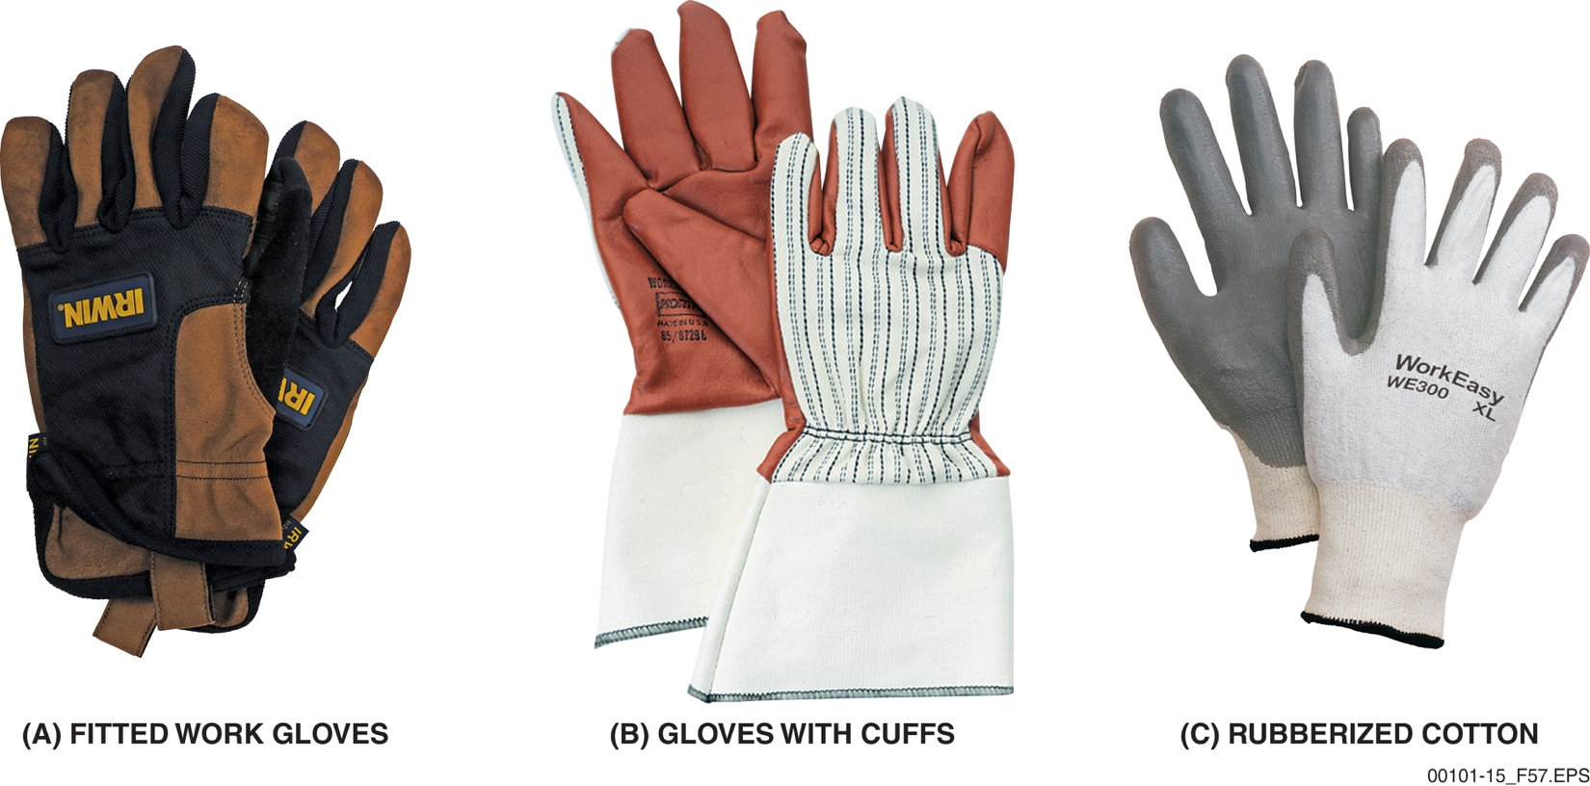
Section 5.1.3 – PPE
Today’s fitted work gloves provide more dexterity than ever before. Gloves with Kevlar® are excellent choices when using sharp tools.
Notes:
Provide a selection of approved work gloves for the trainees to examine. Point out that gloves are rated for certain hazards. Emphasize how important it is to wear gloves at all times except when working around rotating equipment.

Slide 12
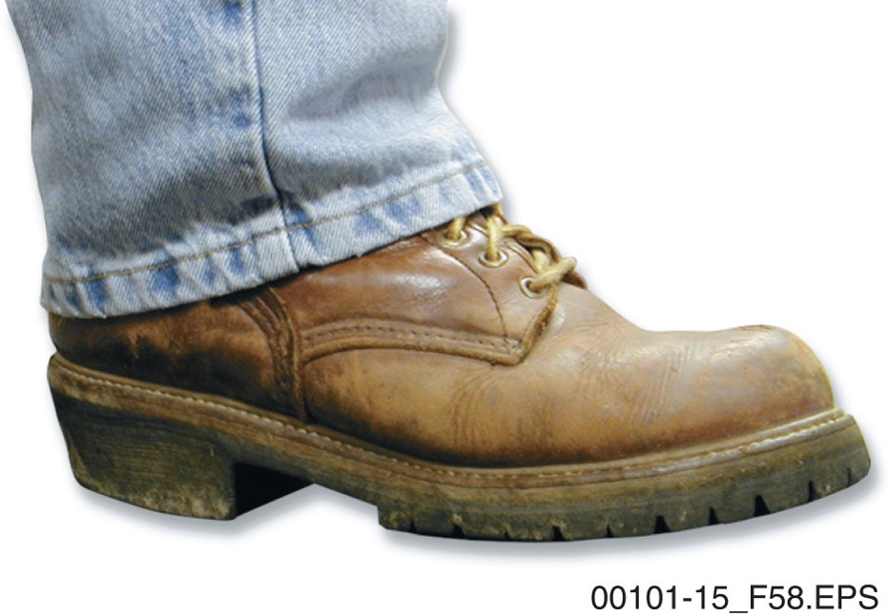
Section 5.1.4 – PPE
FOOTWEAR RULES
Never wear canvas shoes or sandals on the job.
Wear boots that are suited to the site conditions.
Inspect boots often and replace them when worn or damaged.
Notes:
Explain that boots with safety toes are the required footwear for most jobs, but some tasks require specialized footwear. Point out that boots must be frequently inspected and must be replaced when worn or damaged.

Slide 13
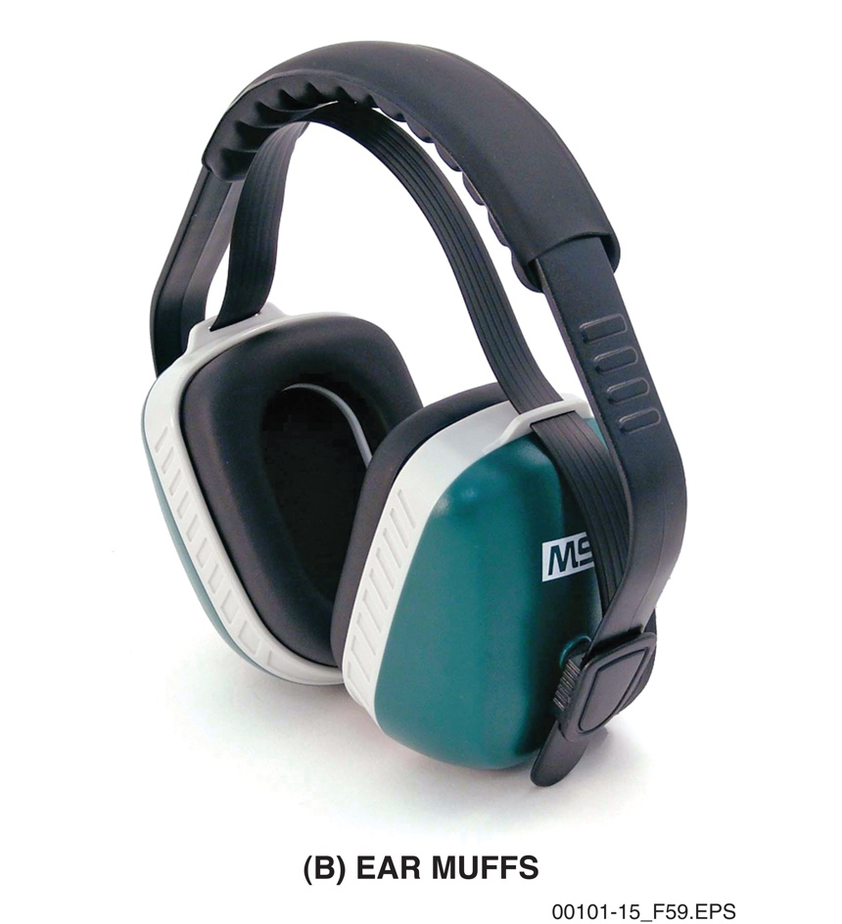
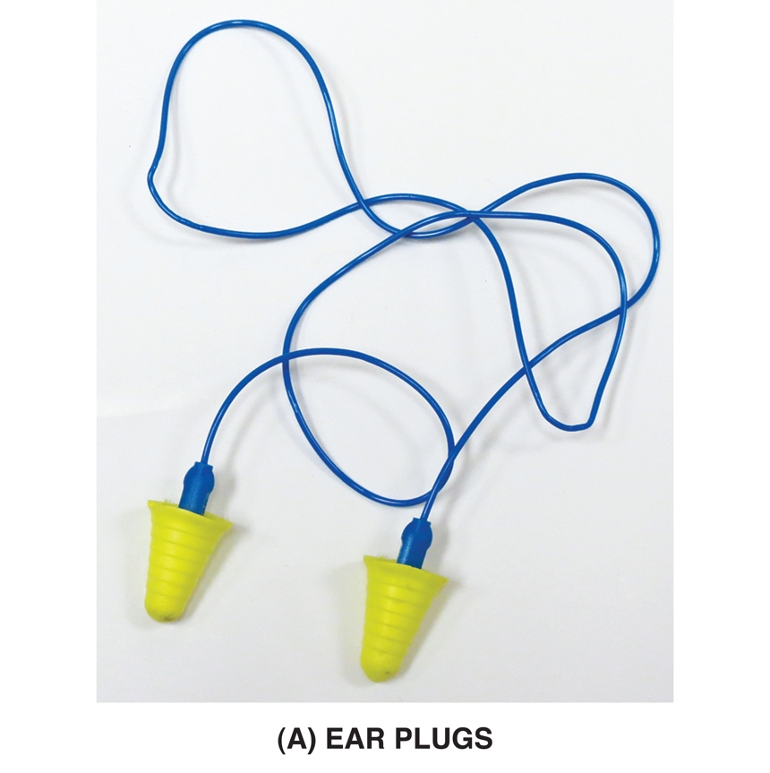
Section 5.1.5 – PPE
Exposure to intense sound over time can result in severe hearing loss.
Notes:
Describe how excessive noise can damage hearing. Provide examples of ear plugs and ear muffs for the trainees to examine.

Slide 14
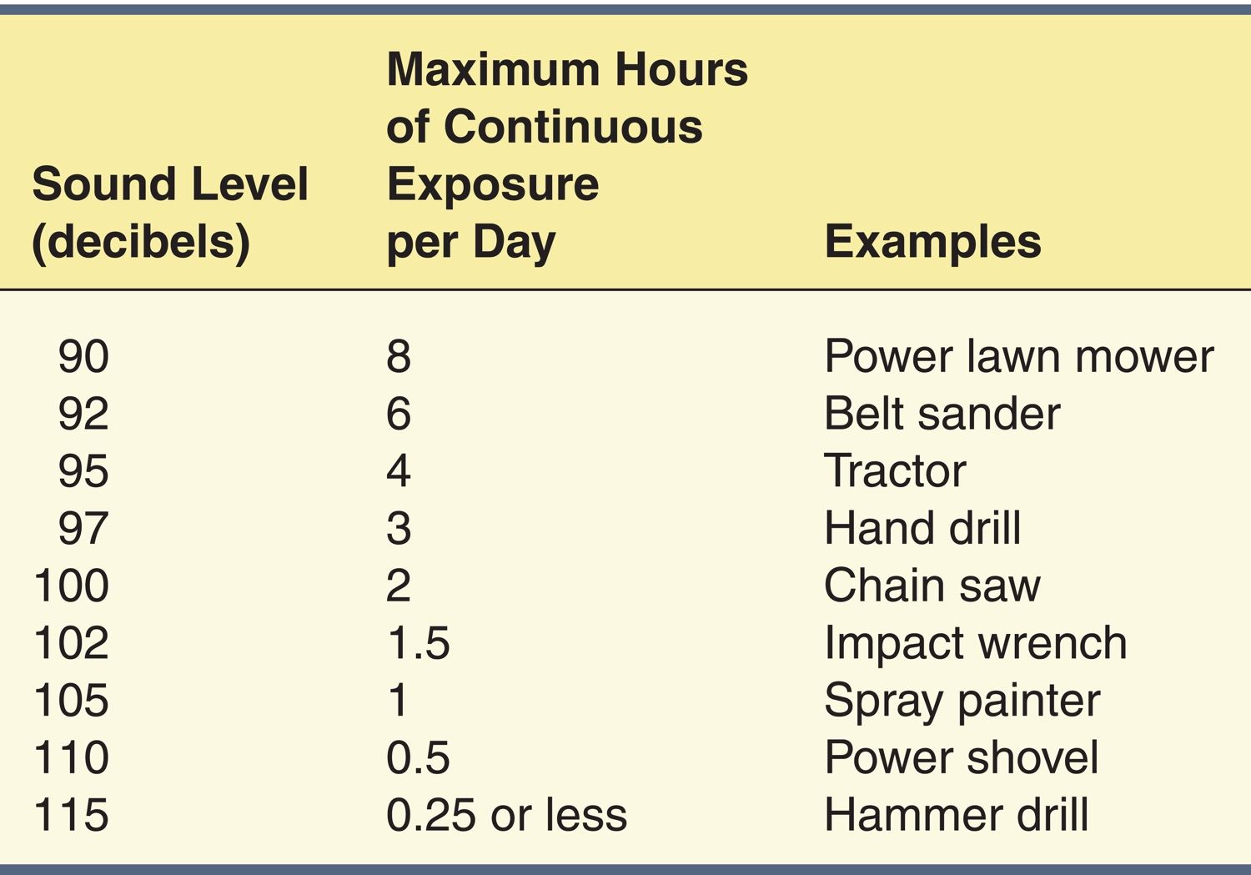
Section 5.1.5 – PPE
Notes:
Use Table 5 to discuss the sound levels that might be experienced on a job site and the maximum exposure time associated with each.

Slide 15
Section 5.2.0 – PPE
RESPIRATORY HAZARDS
Dust from metal grinding
Toxic fumes from welding or flame cutting of some metals
Working with cleaning solvents
Working in low-oxygen environments such as confined spaces
Spray painting
Sand blasting
Drilling concrete
Working with chemicals such as chlorine or ammonia
Notes:
Discuss the conditions under which a respirator may be required. Explain where silica dust comes from and the harmful effects that can result from inhaling it. Explain what asbestos is, where it is found, and the hazards associated with it. Point out that asbestos can only be handled by trained and certified workers.

Slide 16
Section 5.2.0 – PPE
WARNING!
Silica dust from concrete, masonry, and rock are severe respiratory hazards that can result in a lung disease known as silicosis.
Asbestos must not be disturbed. It must be dealt with by specially trained and properly equipped workers.
Notes:
Discuss the conditions under which a respirator may be required. Explain where silica dust comes from and the harmful effects that can result from inhaling it. Explain what asbestos is, where it is found, and the hazards associated with it. Point out that asbestos can only be handled by trained and certified workers.

Slide 17
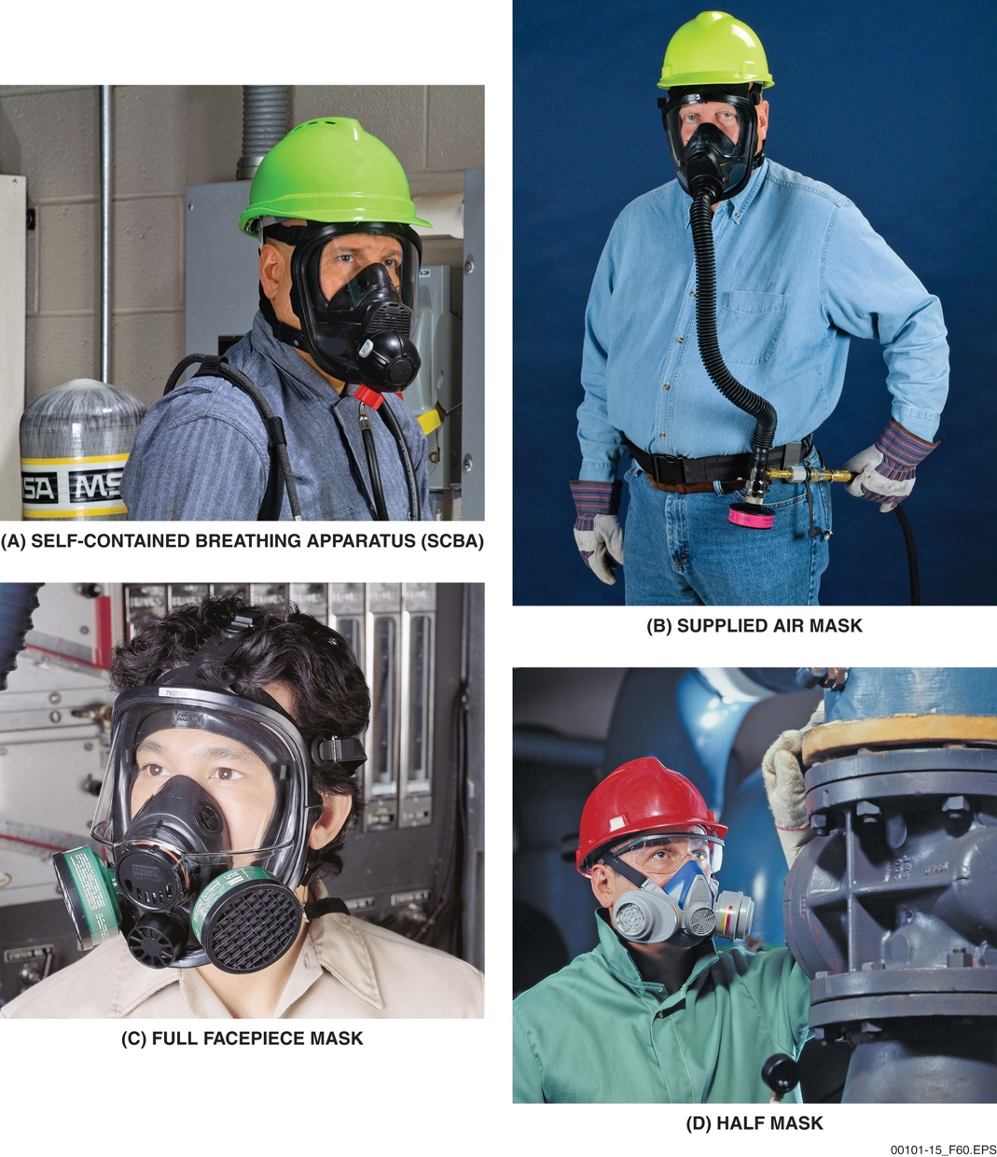
Sections 5.2.1 to 5.2.3 – PPE
USING A RESPIRATOR
Workers must be medically evaluated before using a respirator.
Respirators must be properly fitted and fit checks must be performed before each use.
Notes:
Provide examples of respirators for the trainees to examine. Discuss the different types of respirators and their uses. Explain that, if respirators are required on the job, the employer must provide the necessary equipment and training in how to use it. Point out that respirators are effective only if they fit properly.

Slide 18
Laboratory – PPE
INSPECTING AND APPLYING PPE
PERFORMANCE TASKS 2 AND 3
Notes:
Show the trainees how to properly inspect, don, and remove eye protection, gloves, hard hat, and hearing protection. Point out causes for rejection in common PPE.
Have the trainees demonstrate their ability to properly inspect, don, and remove eye protection, gloves, hard hat, and hearing protection. This activity corresponds to Performance Tasks 2 and 3.

Slide 19
Section 6.1.0 – Site Hazards
SOME SIGNIFICANT HAZARDS
Lead
Bloodborne pathogens
Chemicals
Be sure you are familiar with exposure hazards on the job site, recognize the warning signs, and take the required precautions against exposure.
Notes:
Explain how the HazCom standard applies to workers who may be exposed to chemical, biological, or physical hazards on the job. Point out that exposure to hazardous materials may come through inhalation, ingestion, or absorption. Explain what PEL is.

Slide 20
Sections 6.1.1 and 6.1.2 – Site Hazards
LEAD
Used in piping, batteries, and casting metals.
Commonly found in paint before 1978.
Sanding dust from lead-based paint is very hazardous.
Notes:
Describe the sources of lead and the hazards related to contact with lead on a job site, especially inhalation or ingestion of dust caused by disturbing lead-based paint.

Slide 21
Sections 6.1.1 and 6.1.2 – Site Hazards
BLOODBORNE PATHOGENS
Bloodborne infectious diseases include HIV, Hepatitis B, and Hepatitis C.
Transmitted through contact with blood and other bodily fluids.
Use gloves, eye protection, and masks as needed.
Report any known contact.
Notes:
Explain what bloodborne pathogens are and how a person can come into contact with them. Point out that exposure to bloodborne pathogens can be prevented by wearing protective clothing, masks, and gloves and washing affected areas with soap and water.

Slide 22
Section 6.1.3 – Site Hazards
CHEMICAL HAZARDS
Acids, solvents, and other chemicals can produce toxic vapors or may be flammable.
Some adhesives, paints, and other chemicals can be poisonous. Contact may cause skin irritation, breathing problems, or allergic reaction.
Compressed gases in cylinders such as acetylene and oxygen represent an explosion hazard.
Notes:
Give the trainees examples of chemicals that can be encountered on a job site and describe the various hazards associated with chemical spills, such as release of toxic vapors, explosion, or fire. Remind the trainees to check the related SDS for any chemical they encounter so they will understand the hazards and related protective measures.

Slide 23
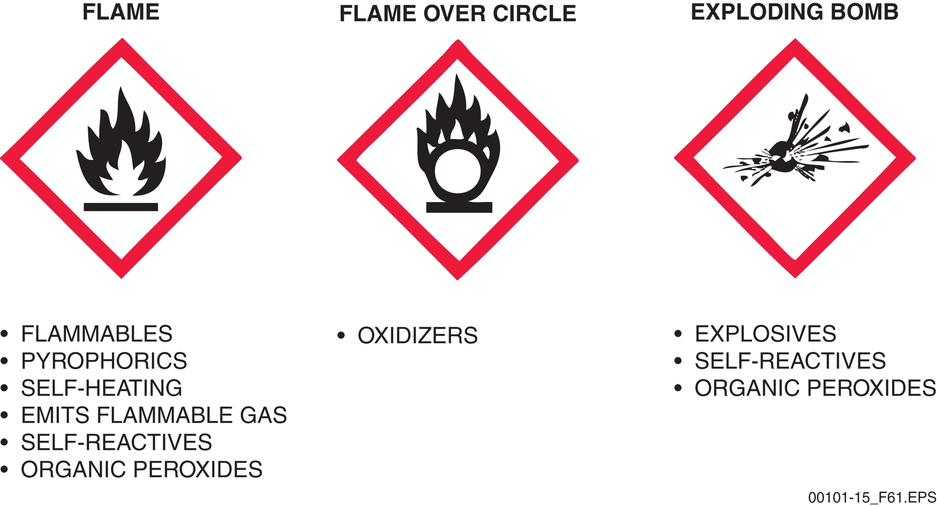
Section 6.1.4 – Site Hazards
Flammable, Combustible, or Explosive Material Identification
Notes:
Describe the chemical labeling requirements under the GHS. Discuss the NFPA and USDOT labeling standards using the figures in the TG.

Slide 24
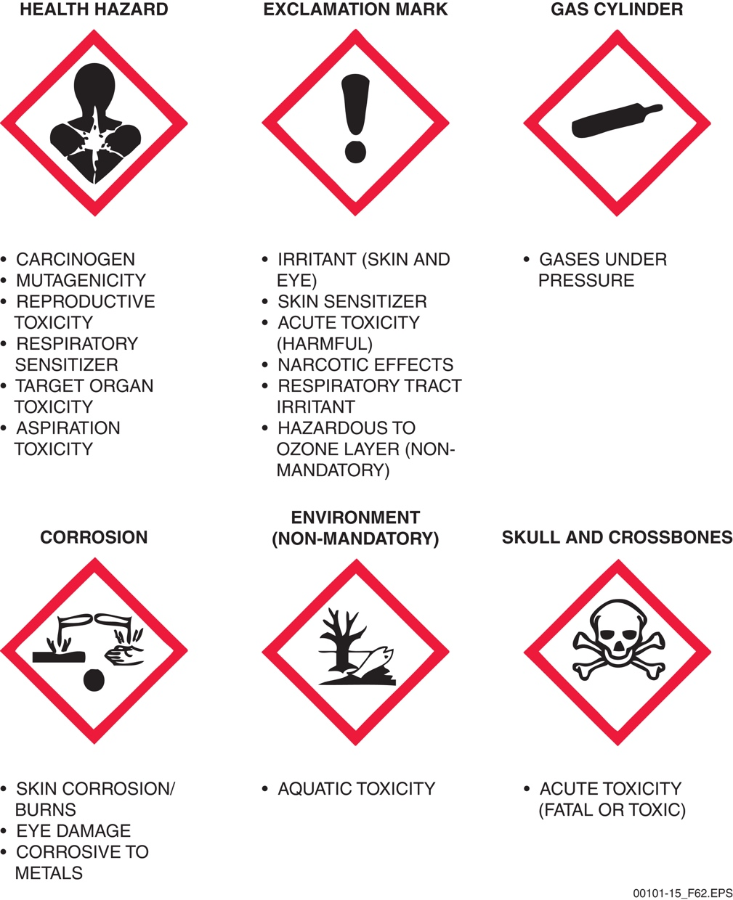
Section 6.1.4 – Site Hazards
Notes:
Describe the chemical labeling requirements under the GHS. Discuss the NFPA and USDOT labeling standards using the figures in the TG.

Slide 25


Sections 6.1.5 and 6.1.6 – Site Hazards
WARNING!
Learn to recognize the symbols for radiation and biohazards. Stay away unless you are properly trained and equipped.
Notes:
Identify sources of radiation and the symbols used to identify radiation hazards. Discuss signs used to identify biological hazards.

Slide 26
Sections 6.2.0 to 6.2.4 – Site Hazards
HEAT-RELATED HEALTH CONCERNS
Heat stress
Heat cramps
Heat exhaustion
Heat stroke
Learn to recognize the symptoms of heat exhaustion and heat stroke and know when to seek medical attention.
Notes:
Explain what heat stress is and identify its symptoms. Describe the causes and symptoms of heat cramps. Point out that it is critical to drink plenty of liquids when working in hot conditions, but to avoid alcoholic beverages. Explain the difference between heat exhaustion and heat stroke and compare the symptoms. Discuss the treatments for these conditions.

Slide 27
Sections 6.2.0 to 6.2.4 – Site Hazards
AVOIDANCE
Drink plenty of water.
Wear lightweight clothing if possible.
Keep your head covered and your face shielded.
Take short breaks in the shade if possible.
Notes:
Discuss the treatments for heat exhaustion and heat stroke.

Slide 28
Sections 6.2.5 to 6.2.7 – Site Hazards
FROSTBITE
Frostbite damages tissue, commonly fingers, toes, and nose
Symptoms include pale, waxy-white skin or hard, numb skin
Never rub the affected area
Move to a warm area and apply warm (not hot) water
Notes:
Describe the symptoms of cold stress. Describe the symptoms and first aid treatment for frostbite.

Slide 29
Sections 6.2.5 to 6.2.7 – Site Hazards
HYPOTHERMIA
Loss of body heat and reduced body temperature
Look for shivering, slurred speech, drowsiness, confusion, and weakness
Move to a warm, dry area and replace wet clothing
Provide warm drinks, but avoid caffeine and alcohol
Notes:
Explain how hypothermia can occur and review its symptoms. Describe how to treat a person with symptoms of hypothermia. Refer the trainees to the text and discuss the actions to take if someone falls into the water.

Slide 30
Sections 6.2.5 to 6.2.7 – Site Hazards
AVOIDING COLD-RELATED INJURY
Dress in layers
Wear waterproof, wind-resistant fabrics and waterproof boots when working outdoors
Wear a hat or cap to reduce heat loss
Carry extra clothing in case of rain
Notes:
Explain that dressing in layers is the best way to avoid cold stress and that dry clothes should be carried in case of damp weather.

Slide 31
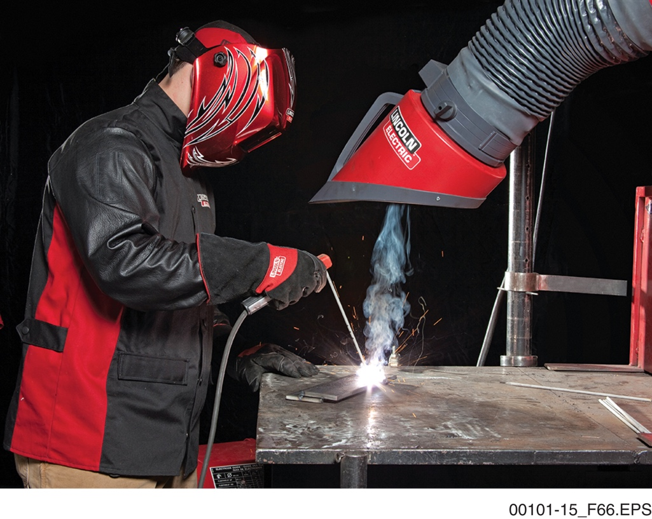
Section 6.3.1 – Site Hazards
ARC WELDING SAFETY
Exposure to the welding arc can result in flash burns to the eyes.
Welding curtains must be used to shield nearby workers from the welding arc.
Anyone in the vicinity must wear shaded lenses as required.
Notes:
Identify the activities that qualify as hot work. Briefly explain how arc welding is performed and discuss the hazards from heat and radiation. Point out that anyone working near an arc welding operation must wear shaded eyewear appropriate to the hazard level and that welding screens may also be necessary to protect nearby workers. Discuss the symptoms of flash burns.

Slide 32
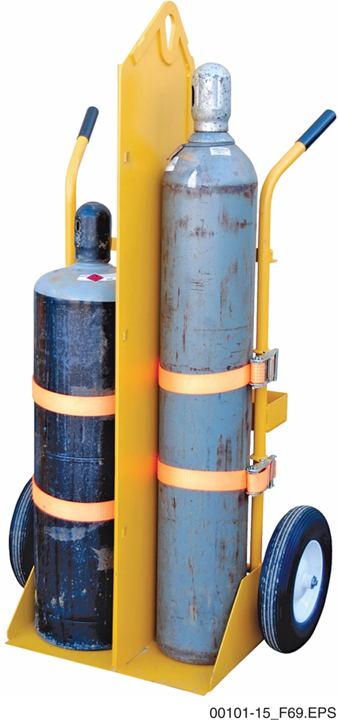
Section 6.3.2 – Site Hazards
Oxygen and fuel gases should be physically separated by a partition on a cart…
Notes:
Explain how oxygen combines with a cutting gas such as acetylene to produce a flame hot enough to melt steel. Briefly explain what brazing is and how it is used to join copper pipe.

Slide 33
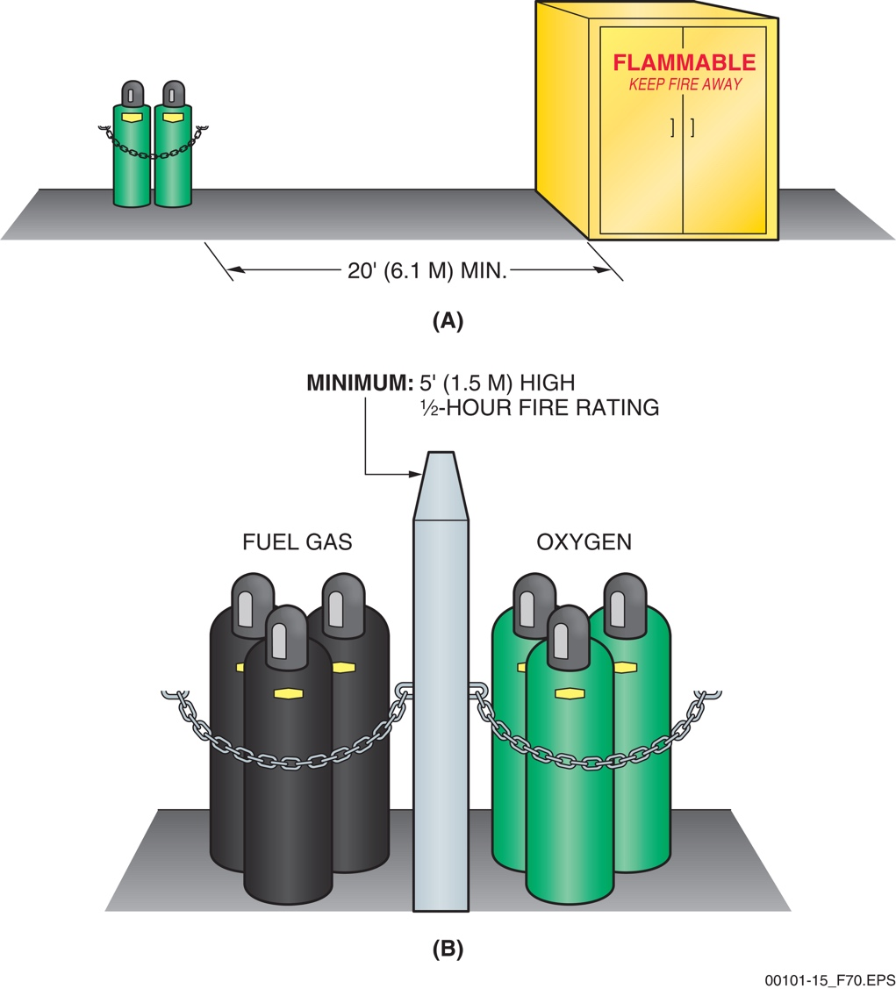
Section 6.3.2 – Site Hazards
… and when in storage.
Notes:
Explain how oxygen combines with a cutting gas such as acetylene to produce a flame hot enough to melt steel. Briefly explain what brazing is and how it is used to join copper pipe.

Slide 34
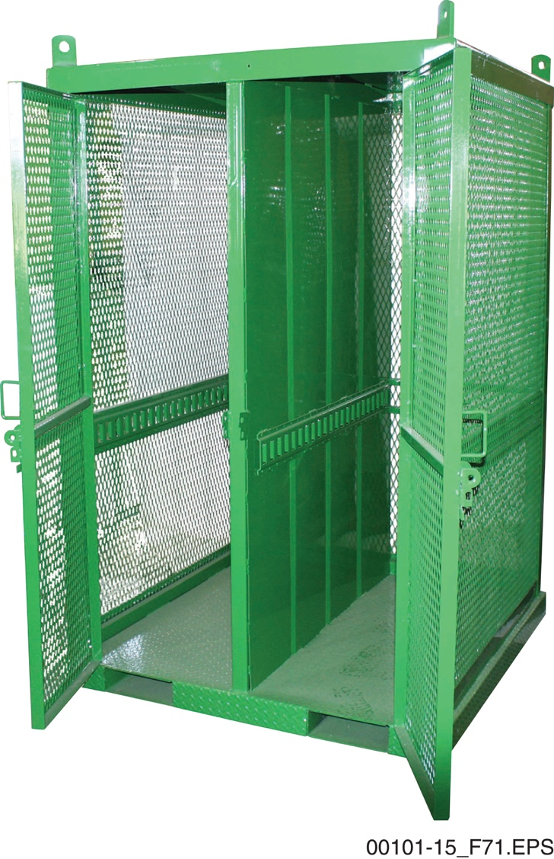
Section 6.3.3 – Gas Cylinders
Never attempt to lift a cylinder using the holes
in a safety cap; use an approved lifting cage.
Notes:
Discuss the importance of properly handling and storing fuel gases under pressure. Point out that protective caps must always be in place on gas cylinders when they are not in use and that the cylinders must be secured to keep them from falling over. Discuss the proper methods for transporting and lifting fuel gas cylinders.

Slide 35
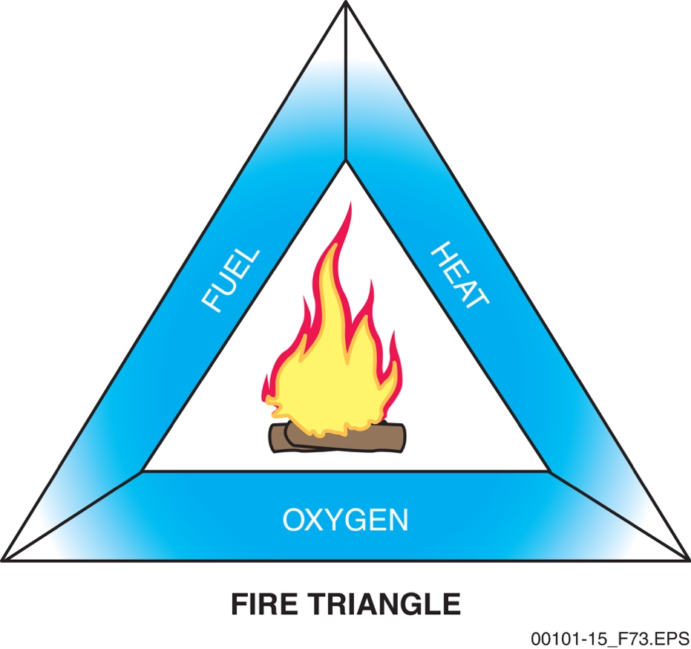
Sections 6.4.0 to 6.4.2 – Fire
All three components are necessary to start a fire. However, these three things are readily available more often than you may think.
Notes:
Use the fire triangle to describe the conditions necessary for a fire to start and be sustained. Describe the different types of combustible materials and how they are classified. Emphasize the importance of keeping pressurized gas cylinders away from sources of heat.

Slide 36
Section 6.4.3 – Fire
FIRE PREVENTION
Always work in a well-ventilated area.
Never smoke or light matches when working with or near flammable materials.
Keep oily rags in approved, self-closing metal containers.
Store combustible materials only in approved containers.
Notes:
Review the basic safety guidelines for fire prevention. Discuss the techniques used to prevent fire when working with flammable or combustible liquids, flammable gases, and ordinary combustibles. Point out the hazards of allowing oxygen to come into contact with oil or grease.

Slide 37
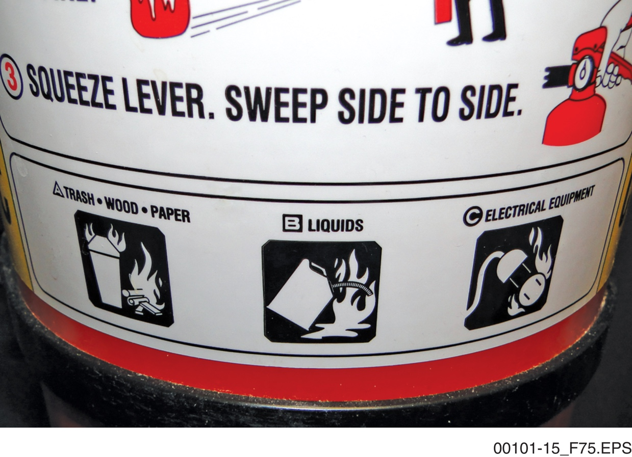
Section 6.4.4 – Fire
It is crucial to select the right extinguisher and to use it correctly.
Notes:
Explain the importance of knowing where fire extinguishers are located and the procedures to be followed in case of a fire. Explain how fire extinguishers are classified for specific types of fires and why this is necessary. Ask a trainee what might happen if a Class A fire extinguisher is used on an electrical fire.

Slide 38
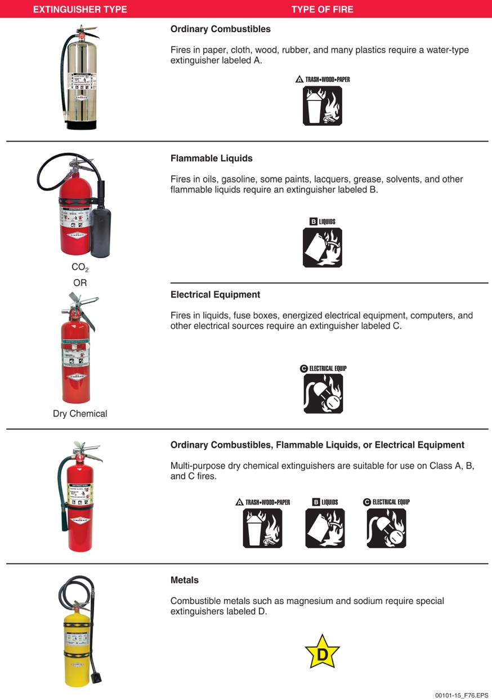
Section 6.4.4 – Fire
Notes:
Show and explain the pictograms provided on fire extinguishers. Point out that dry-chemical extinguishers are common because they can be used on Class A, B, and C fires. Discuss the hazards of using a CO₂ extinguisher on a Class D fire. Point out that fire extinguishers must be periodically inspected and show how to determine if an extinguisher is fully charged.

Slide 39
Section 6.4.4 – Fire
WARNING!
Do not use a CO₂ extinguisher on a Class D fire, as it can cause the fire to spread. Also note that CO₂ is heavier than air, so it will concentrate in low areas, displacing oxygen. For that reason, a CO₂ extinguisher must never be taken into, or used in, a confined space.

Slide 40
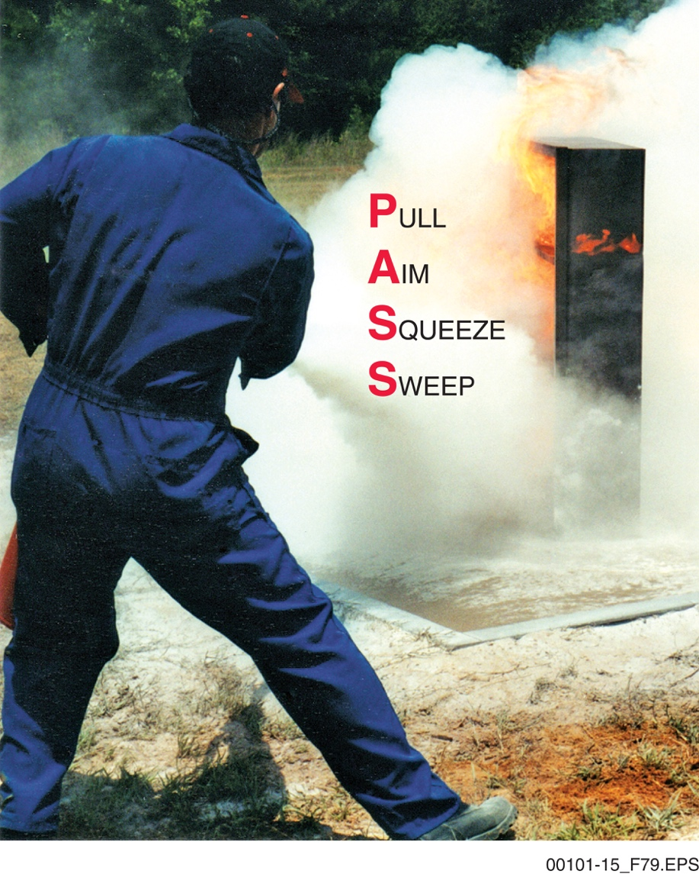
Section 6.4.5 – Fire
THE PASS METHOD

Slide 41
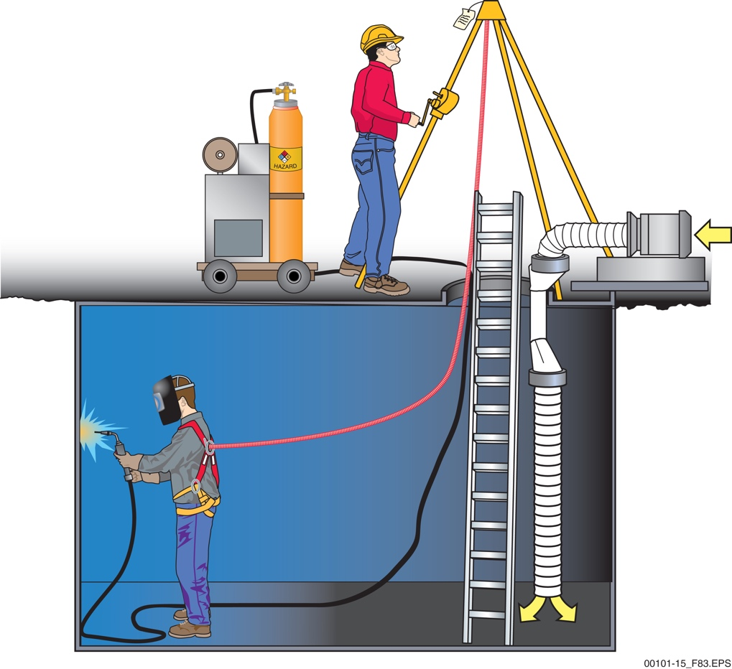
Section 6.5.0 – Confined Spaces
Think about the space where you need to work. Does it fit the description of a confined space, requiring special preparations?
Notes:
Explain what a confined space is and give examples. Explain how a permit-required confined space is different and what must be done before it is entered. Describe what oxygen-deficient and oxygen-enriched spaces are and discuss the related hazards. Point out that an attendant must be present when a confined space is entered and that the attendant must remain outside a permit-required confined space.

Slide 42
Section 6.5.0 – Confined Spaces
WARNING!
Without the proper training, no employee is allowed to enter a permit-required or non-permit-required confined space. Employers are required to have programs to control entry into, and hazards in, both types of confined spaces.
Notes:
Explain why special care is needed when using flammable or inert gases in a confined space.

Slide 43
Wrap Up – Trade Terms
Arc welding
The joining of metal parts by fusion, in which the necessary heat is produced by means of an electric arc.
Brazing
A process using heat in excess of 800ºF (427ºC) to melt a filler metal that is drawn into a connection. Brazing is commonly used to join copper pipe.
Flash burn
The damage that can be done to eyes after even brief exposure to ultraviolet light from arc welding. A flash burn requires medical attention.
Notes:
Review the Trade Terms introduced in this session to verify that the trainees are familiar with the terms. Have the trainees define the term, and then click to have the definitions appear, one at a time.

Slide 44
Wrap Up – Trade Terms
Flash point
The temperature at which fuel gives off enough gases (vapors) to burn.
Permit-required confined space
A confined space that has been evaluated and found to have actual or potential hazards, such as a toxic atmosphere or other serious safety or health hazard. Workers need written authorization to enter a permit-required confined space. Also see confined space.
Notes:
Review the Trade Terms introduced in this session to verify that the trainees are familiar with the terms. Have the trainees define the term, and then click to have the definitions appear, one at a time.

Slide 45
Wrap Up – Trade Terms
Qualified person
A person who, by possession of a recognized degree, certificate, or professional standing, or by extensive knowledge, training, and experience, has demonstrated the ability to solve or prevent problems relating to a certain subject, work, or project.
Welding curtain
A protective screen set up around a welding operation designed to safeguard workers not directly involved in that operation.
Wind sock
A cloth cone open at both ends mounted in a high place to show which direction the wind is blowing.
Notes:
Review the Trade Terms introduced in this session to verify that the trainees are familiar with the terms. Have the trainees define the term, and then click to have the definitions appear, one at a time.

Slide 46
Next Session…
LABORATORY AND PERFORMANCE TASK:
Setting Up and Using a Ladder
MODULE EXAMINATION
Review the complete module to prepare for the upcoming laboratory session and module exam.

