Slide 1
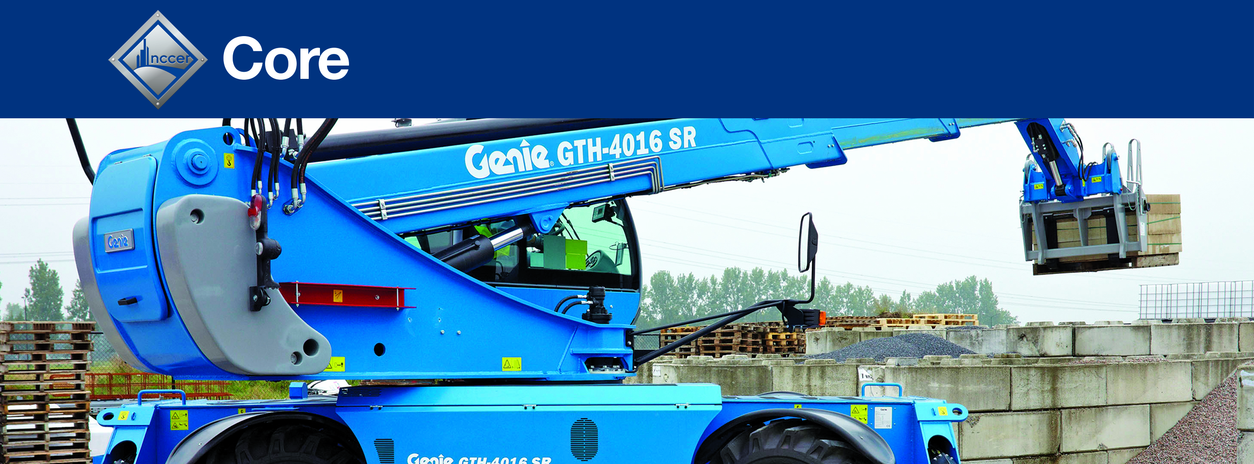
Module 00109
Introduction to Material Handling
Copyright © 2021 by NCCER, Alachua, FL 32615. Published by Pearson. All rights reserved.

Slide 2
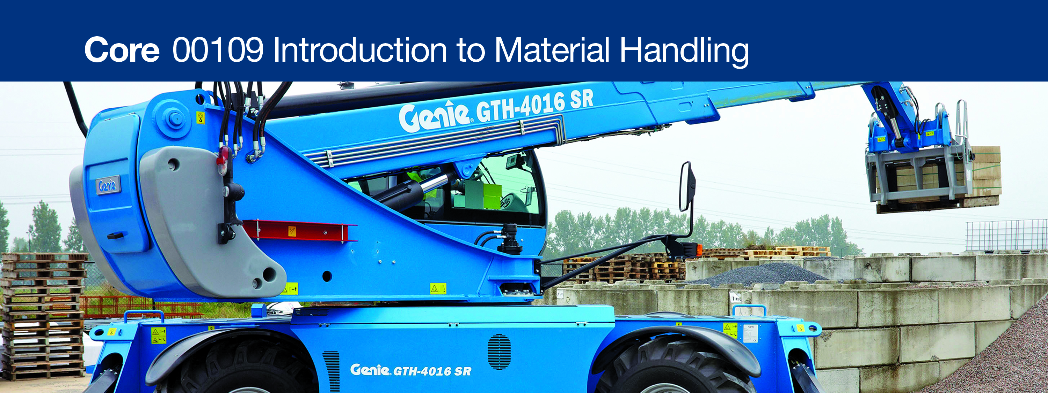
2.0.0 Material Handling Equipment

Slide 3
Objective
Successful completion of this module prepares you to do the following:
Identify various types of material handling equipment and describe how they are used.
  Identify non-motorized material handling equipment and describe how they are used.
  Identify motorized material handling equipment and describe how they are used.

Slide 4
Performance Tasks
There are no performance tasks in this section.
Module 00109 – Introduction to Material Handling

Slide 5
Trade Terms (1 of 4)
Material carts: Four-wheeled devices used to transport materials around a job site.
Hand trucks: Two-wheeled carts that are used to transport large, heavy loads; also known as a dolly.
Cylinder carts: Two-wheeled carts that are used to transport cylinders, or bottles, of compressed gases.
Drum dollies: Wheeled circular platforms or a caddies with a handle that are used to transport lighter-weight 55-gallon drums/barrels.
Drum carts: Wheeled carts that are used to transport heavier-weight 55-gallon drums/barrels.
Module 00109 – Introduction to Material Handling

Slide 6
Trade Terms (2 of 4)
Roller skids: Devices that include a surface table and two, three, or four roller skids. Materials that are to be moved are placed on the table surface and then pushed on the skids.
Wheelbarrows: One- or two-wheeled vehicles with handles at the rear that are used to carry small loads.
Pipe mules: Two-wheeled devices used to transport medium-length pieces of pipe, tubing, or scaffolding; sometimes referred to as a tunnel buggy.
Pipe transports: Wheeled devices similar to a pipe mule, but used to move larger pieces of pipe.
Module 00109 – Introduction to Material Handling

Slide 7
Trade Terms (3 of 4)
Pallet jacks: Devices used to lift and move heavy or stacked pallets; also known as a pallet truck.
Spotter: A person who walks in front of another worker who is carrying or transporting a long load to ensure there is a clear, unobstructed path.
Powered wheelbarrow: A vehicle similar to a manual wheelbarrow, but powered by an electric or gas motor; also known as a power buggy.
Concrete mule: A wheeled device used when a concrete pour is in a location that a concrete delivery truck or pump cannot reach; sometimes referred to as a Georgia buggy.
Freight elevator: An elevator used to transport materials from floor to floor.
Module 00109 – Introduction to Material Handling

Slide 8
Trade Terms (4 of 4)
Industrial forklift: A vehicle with a power-operated pronged platform that can be raised and lowered for insertion under a load to be lifted and moved.
Rough terrain forklift: Similar to an industrial forklift, but designed to be used on rough surfaces. Rough terrain forklifts are characterized by large pneumatic tires, usually with deep treads that allow the vehicle to grab onto the roughest of roads or ground cover without sliding or slipping.
Work zone: The area in which a forklift may come in contact with objects or people, either with the rear end or the front forks.
Module 00109 – Introduction to Material Handling

Slide 9
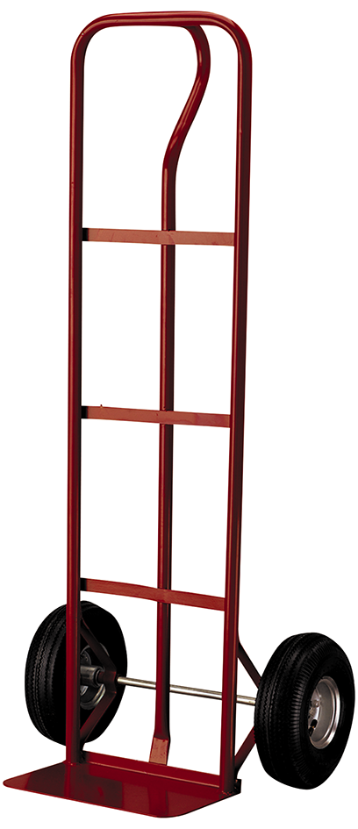
2.1.2 Hand Trucks
Hand trucks, also known as dollies, are
two-wheeled carts that are used to transport large, heavy loads, such as appliances or stacks of heavy boxes.
Many hand trucks are equipped with ratchet straps to secure loads.

Slide 10
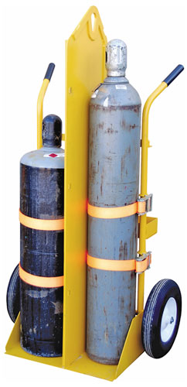
2.1.3 Cylinder Carts
Cylinder carts are designed for transporting compressed gas cylinders, which are explosion hazards. Use carts with a
partition when transporting oxygen and
any fuel gas cylinder together.

Slide 11
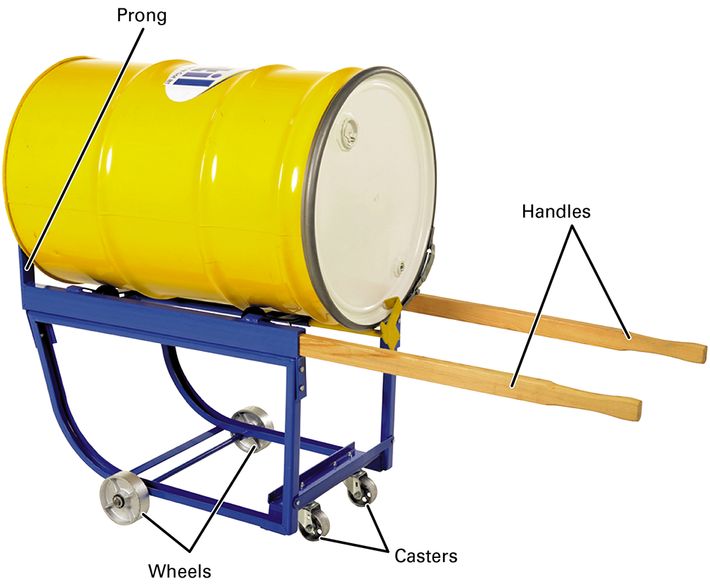
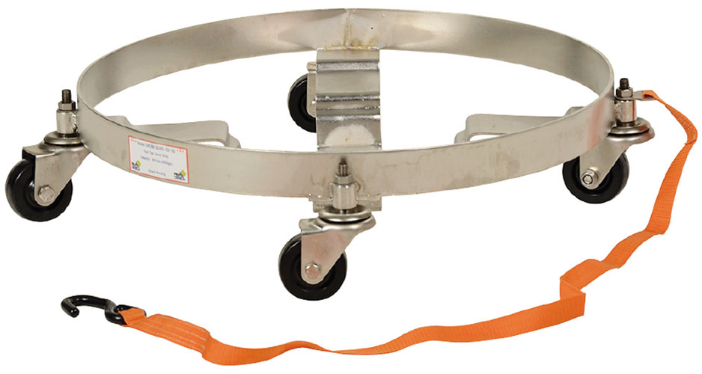
2.1.4 Drum Dollies and Carts
Drum dollies are excellent for drums kept upright, making them easy to move on a smooth floor. For transporting a cylinder longer distances, a drum cart is best.

Slide 12
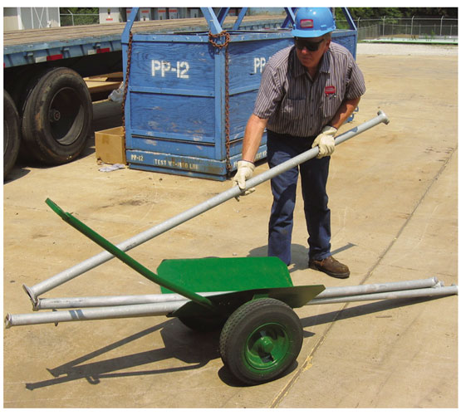
2.1.7 – Pipe Mule
Two-wheeled devices for transporting medium-length pipes, tubing, or scaffolding.
Also called a tunnel buggy, V-cart, or grasshopper.
Requires use of proper lifting techniques and a spotter for full lengths of pipe.

Slide 13
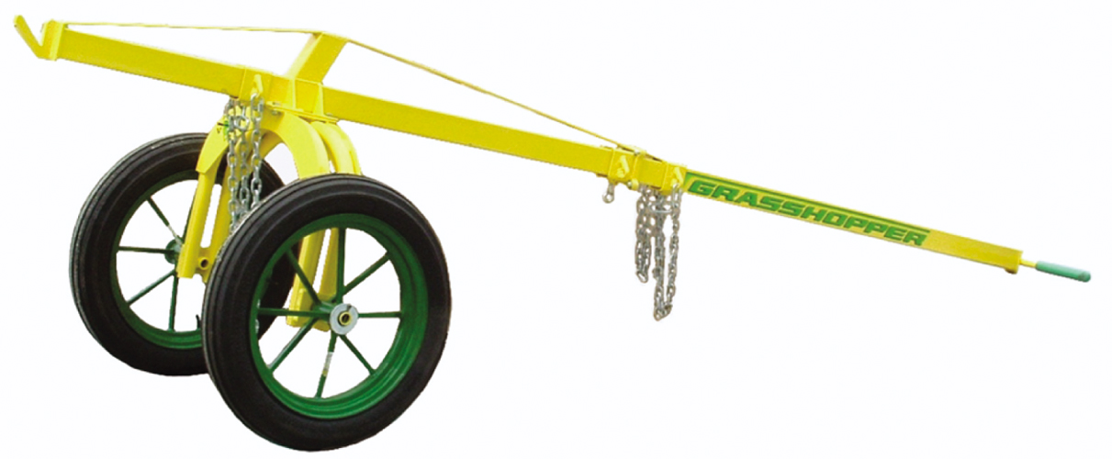
2.1.8 – Pipe Transports
Similar to a pipe mule but used for larger pieces of pipe.
Has frame attached to two rubber wheels.
Requires two people to operate it.

Slide 14
2.2.0 – Motorized Material Handling Equipment
Operators of equipment powered by gasoline or electric motors must…
be properly trained, certified, and authorized.
know the weight of the load.
never exceed the load-handling capacity of the equipment.
inspect the equipment before using it.

Slide 15
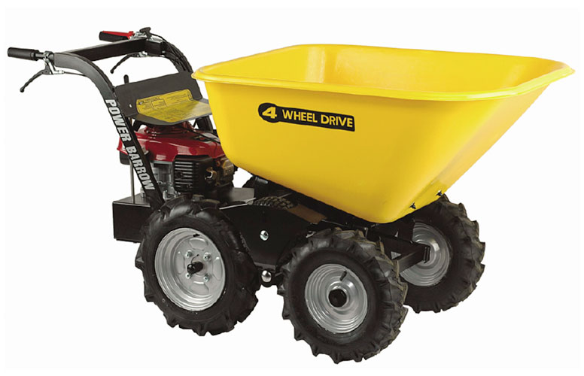
2.2.1 – Powered Wheelbarrow
Powered by an electric or gas motor.
Requires pre-use inspection.
Has specific guidelines for safe operation.

Slide 16
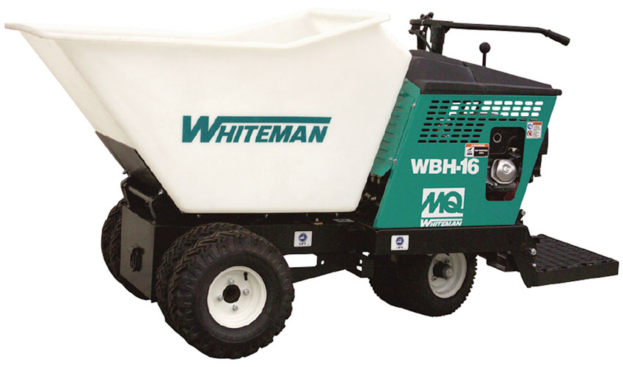
2.2.2 – Concrete Mule
A wheeled device for concrete pours in locations where concrete delivery truck or pump cannot reach.
Designed to carry materials such as concrete, sand, or gravel (concrete-related material).
Requires pre-use inspection.

Slide 17
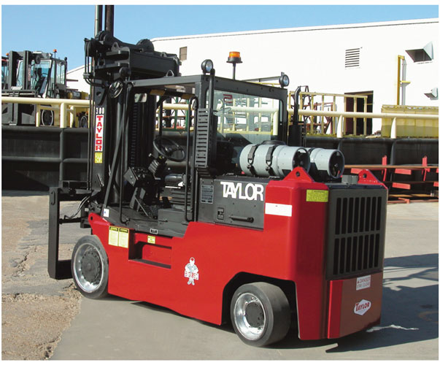
2.2.4 – Industrial Forklift (1 of 2)
A vehicle with a power-operated pronged platform for lifting, lowering, and transporting large or heavy loads.
Used in smooth terrain areas.
Requires daily pre-use inspection.

Slide 18
2.2.4 – Industrial Forklift (2 of 2)
Before operating the forklift each day, inspect the following:
Tires
Fluid levels
Battery/fuel level
Fire extinguisher
Brakes
Deadman control
Warning lights
Horn
Backup alarm

Slide 19
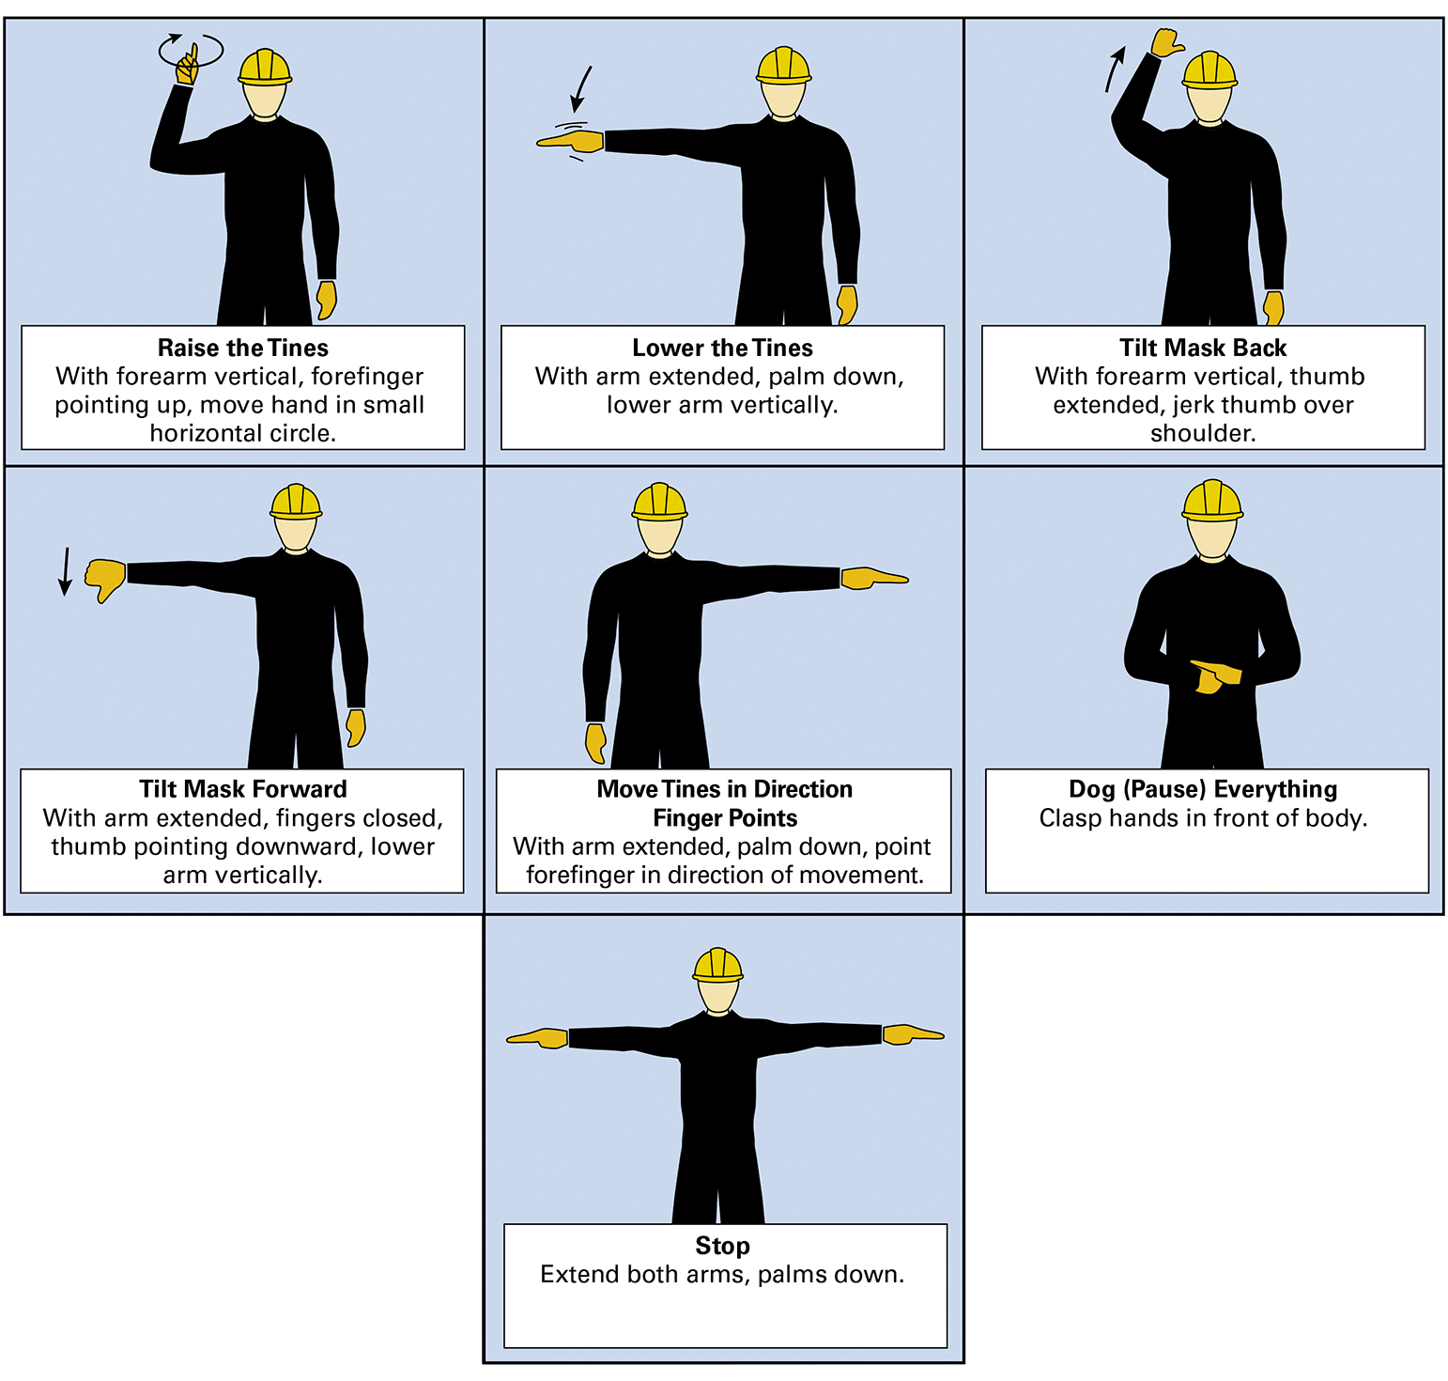
2.2.6 – Hand Signals

Slide 20
2.0.0 Section Review Question One
material cart
Two-wheeled cart that is used to transport large, heavy loads is called a ________.
hand truck
cylinder cart
drum cart

Slide 21
2.0.0 Section Review Question One Answer
material cart
Two-wheeled cart that is used to transport large, heavy loads is called a ________.
hand truck
cylinder cart
drum cart

Slide 22
2.0.0 Section Review Question Two
leather belt
Use a ________ to secure a load on a hand truck.
rubber cord
bungee cord
ratchet strap

Slide 23
2.0.0 Section Review Question Two Answer
leather belt
Use a ________ to secure a load on a hand truck.
rubber cord
bungee cord
ratchet strap

Slide 24
2.0.0 Section Review Question Three
drum dolly
A ________ is used to move heavy drums or barrels.
drum cart
material cart
wheelbarrow

Slide 25
2.0.0 Section Review Question Three Answer
drum dolly
A ________ is used to move heavy drums or barrels.
drum cart
material cart
wheelbarrow

Slide 26
2.0.0 Section Review Question Four
powered wheelbarrow
A vehicle with a power-operated
pronged platform that can be raised and lowered for insertion under a load to be lifted and moved is called a(n) ________.
freight elevator
industrial forklift
pallet jack

Slide 27
2.0.0 Section Review Question Four Answer
powered wheelbarrow
A vehicle with a power-operated
pronged platform that can be raised and lowered for insertion under a load to be lifted and moved is called a(n) ________.
freight elevator
industrial forklift
pallet jack

Slide 28
2.0.0 Section Review Question Five
brakes
Before operating a forklift each day, inspect all of these except the ________.
fire extinguisher
battery/fuel level
brake lights

Slide 29
2.0.0 Section Review Question Five Answer
brakes
Before operating a forklift each day, inspect all of these except the ________.
fire extinguisher
battery/fuel level
brake lights

Slide 30
Next…
Module Review and Exam
Review the complete module to prepare for the Module Exam. In addition, complete the Module Review.

