Slide 1
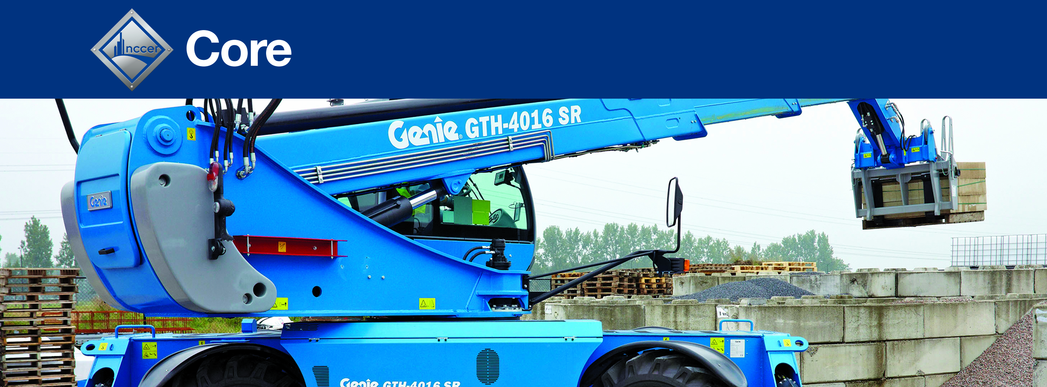
Module 00109
Introduction to Material Handling
Copyright © 2021 by NCCER, Alachua, FL 32615. Published by Pearson. All rights reserved.

Slide 2
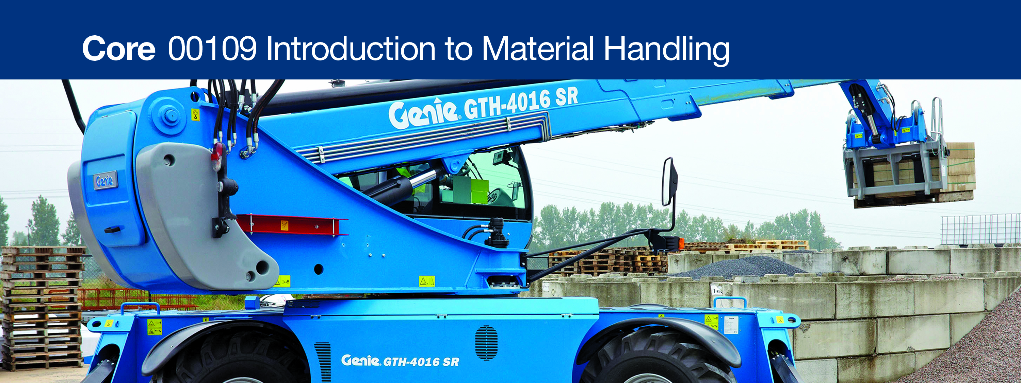
1.0.0 Material Handling

Slide 3
Objective
Successful completion of this module prepares you to do the following:
Identify the basic concepts of material handling and common safety precautions.
  Describe the basic concepts of material handling and manual lifting.
  Identify common material handling safety precautions.
  Identify and describe how to tie knots commonly used in material handling.

Slide 4
Performance Tasks
Under supervision, you should be able to do the following:
Demonstrate safe manual lifting techniques.
Demonstrate how to tie two of the following common knots:
  Square
  Bowline
  Half hitch
  Clove hitch
  k
  dx
Module 00109 – Introduction to Material Handling

Slide 5
Trade Terms (1 of 2)
Square knot: A knot made of two reverse half-knots and typically used to join the ends of two ropes of similar diameters; also called a reef knot.
Bowline: A knot used to form a loop that neither slips nor jams; sometimes referred to as a rescue knot or the king of knots.
Half hitch: A knot tied by passing the working end of a rope around an object, across the standing part of the rope, and then through the resulting loop; often used as an element in forming other knots or added to make other knots more secure.
Module 00109 – Introduction to Material Handling

Slide 6
Trade Terms (2 of 2)
Clove hitch: A knot that consists of two half hitches made in opposite directions; used to temporarily secure a rope to an object.
Standing end: The end of a rope that is not being knotted.
Working end: The end of a rope that is being used to tie a knot.
Standing part: The portion of a rope that is between the standing end and the working end.
Capsize: To change the form and rearrange the parts of a knot, usually by pulling on specific ends of the knot.
Module 00109 – Introduction to Material Handling

Slide 7
1.1.0 – Material Handling Basics
To prevent injuries when handling materials:
Pre-plan the task.
Wear appropriate PPE.
Follow proper lifting procedures.
Be aware of hazards posed by heights and suspended loads.

Slide 8
1.1.1–1.1.2 – Pre-Task Planning and Personal Protective Equipment
Basic Guidelines
Assess the situation before attempting a lift.
Wear the proper clothing.
Use the appropriate PPE.
Follow established policies.

Slide 9
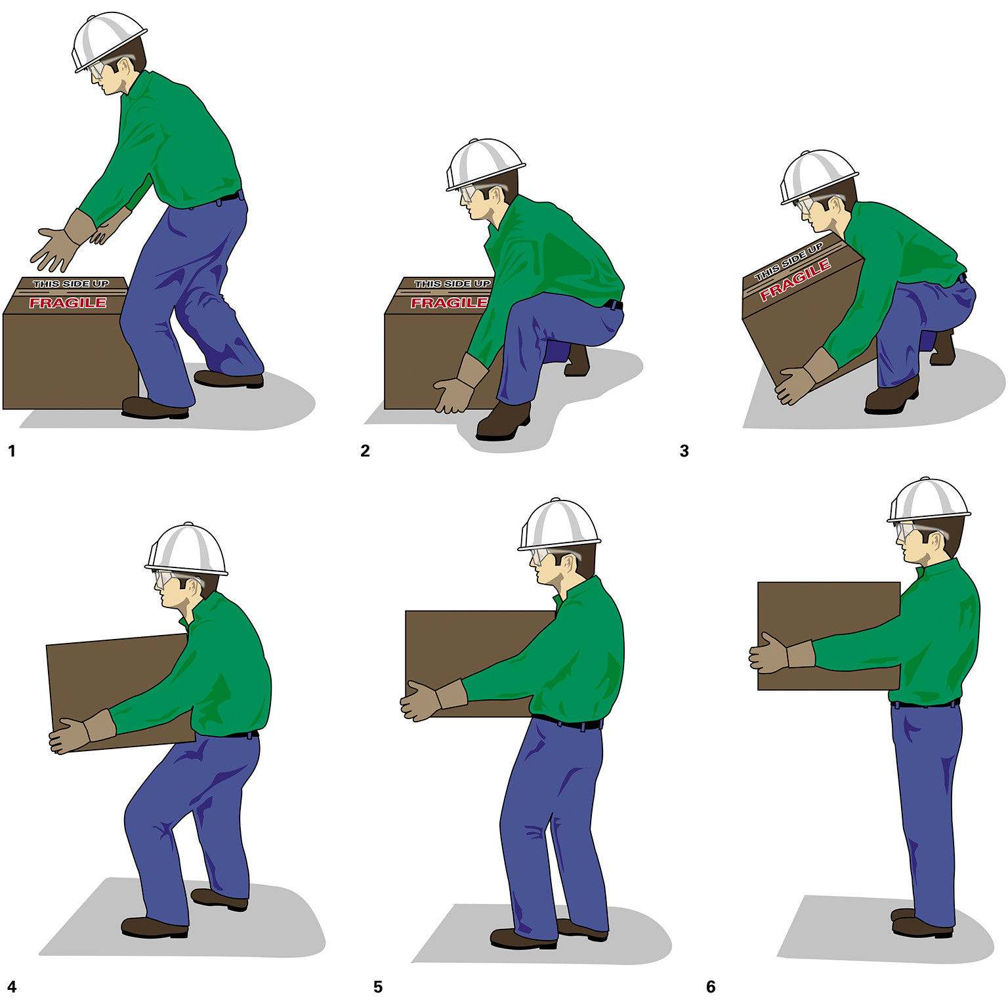
1.1.3 – Proper Lifting and Lowering Procedures (1 of 2)
Safe Lifting Technique

Slide 10
1.1.3 – Proper Lifting and Lowering Procedures (2 of 2)
Guidelines for Lowering a Load
Size up the load first.
Lower the load in the same way it would be lifted.
Treat the area that the load is being lowered into
as a fall zone.

Slide 11
1.2.1 – Stacking and Storing Materials (1 of 3)
Follow safety guidelines for stacking and storing items such as:
Cartons
Lumber
Pipes
Items that should be chocked
Items that should be tied down or banded
Bags
Bricks
Masonry blocks
Flammable materials
Always properly store materials and equipment when they are not in current use

Slide 12
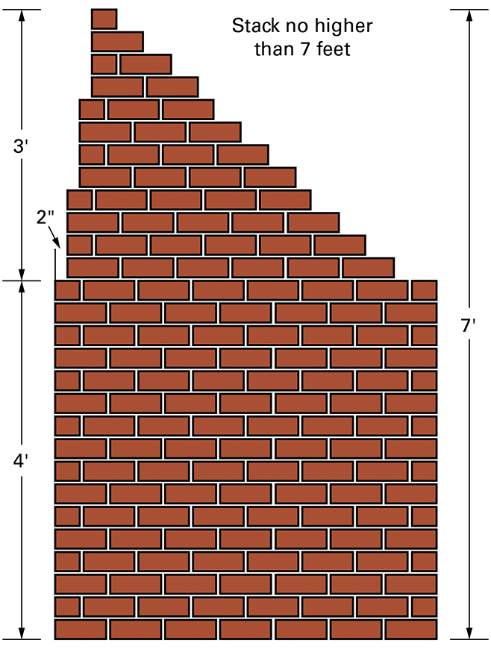
1.2.1 – Stacking and Storing Materials (2 of 3)
Stack loose bricks no higher than seven feet (2.1 m). Above four feet (1.2 m), begin stacking two inches (5 cm) in from the edge, continuing in this manner for each additional foot of height up to seven feet (2.1 m).

Slide 13
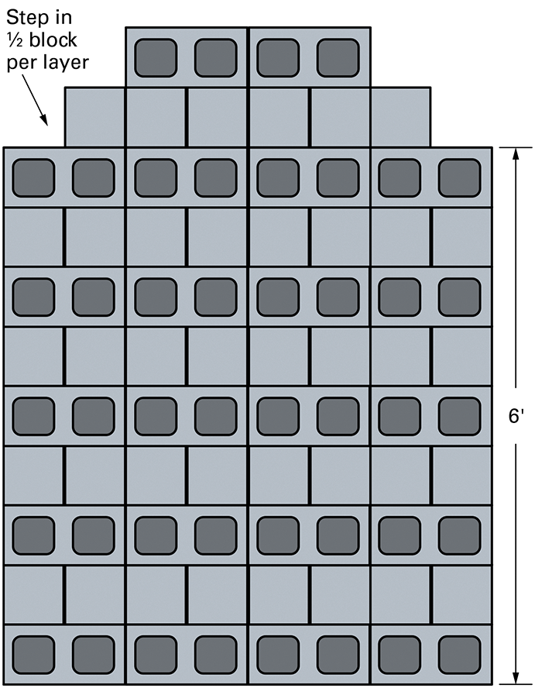
1.2.1 – Stacking and Storing Materials (3 of 3)
A stack of masonry blocks is set back one-half block per layer above six feet (1.8 m).

Slide 14
1.2.2 – Working from Heights
Safety Guidelines
Use a safety harness with a fall-arrest lanyard at heights over 6 feet (2 m).
Use a rope to raise or lower tools and materials.
Tie off tools and materials to keep them secured in elevated work areas.
Follow precautions to use ladders safely.
Never stack or store materials on scaffolds or runways.

Slide 15
1.3.0 – Knots for Material Handling
Knots and Hitches
True knots must be unwoven to be unfastened.
Hitches can be undone by pulling in the reverse direction from that in which the knots are meant to hold.
Key knot-tying terms are: standing end, working end, standing part, and capsize.

Slide 16
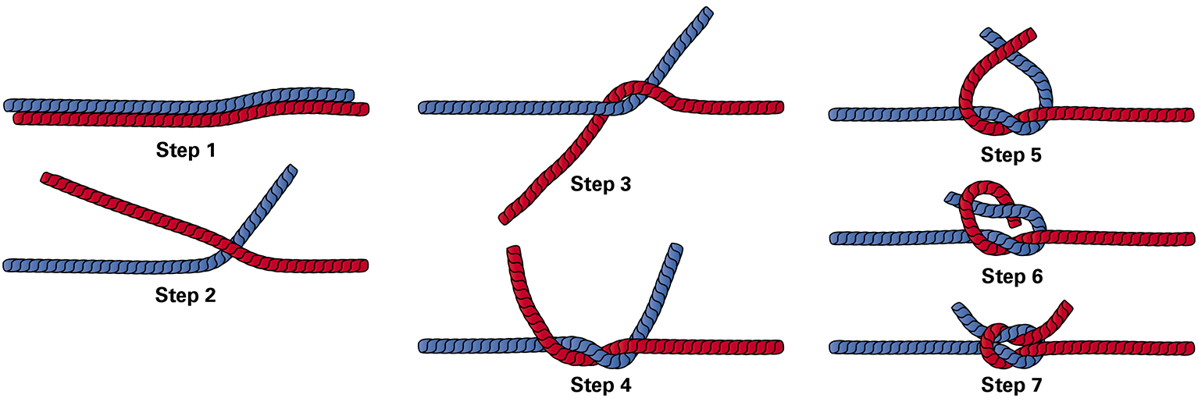
1.3.1 – The Square Knot (1 of 2)

Slide 17
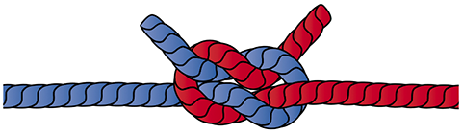
1.3.1 – The Square Knot (2 of 2)
The granny knot is the result if the second half knot is tied in the wrong direction when tying a square knot. It is a highly insecure knot!

Slide 18
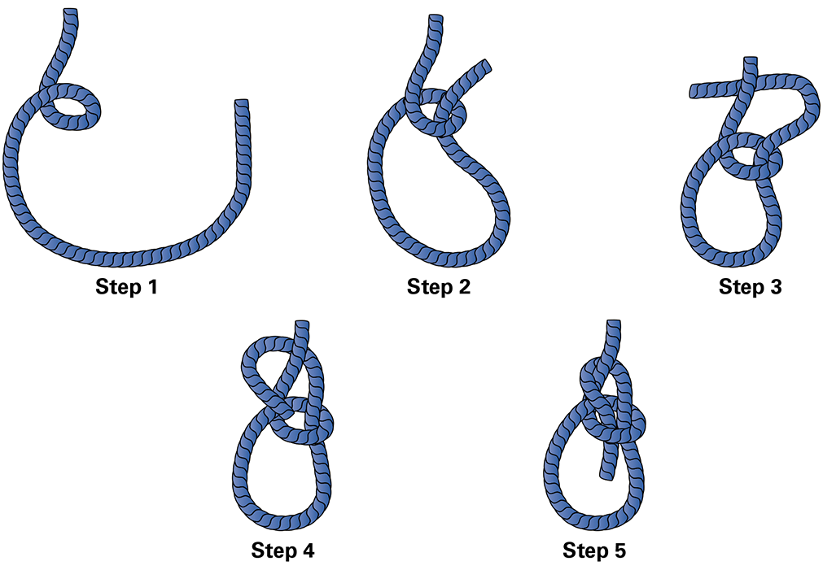
1.3.2 – The Bowline
Do not use this knot if the rope may have to be released while under load!

Slide 19
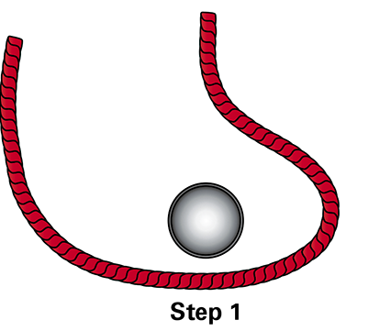
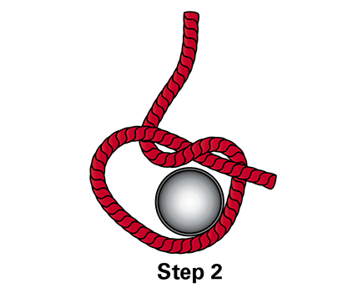
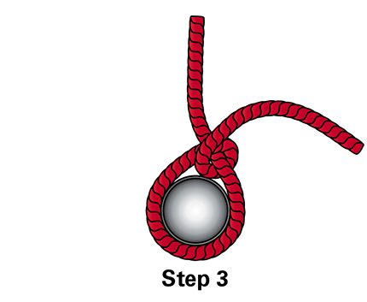
1.3.3 – The Half Hitch
Do not use this knot alone for heavy loads or when safety is critical!

Slide 20
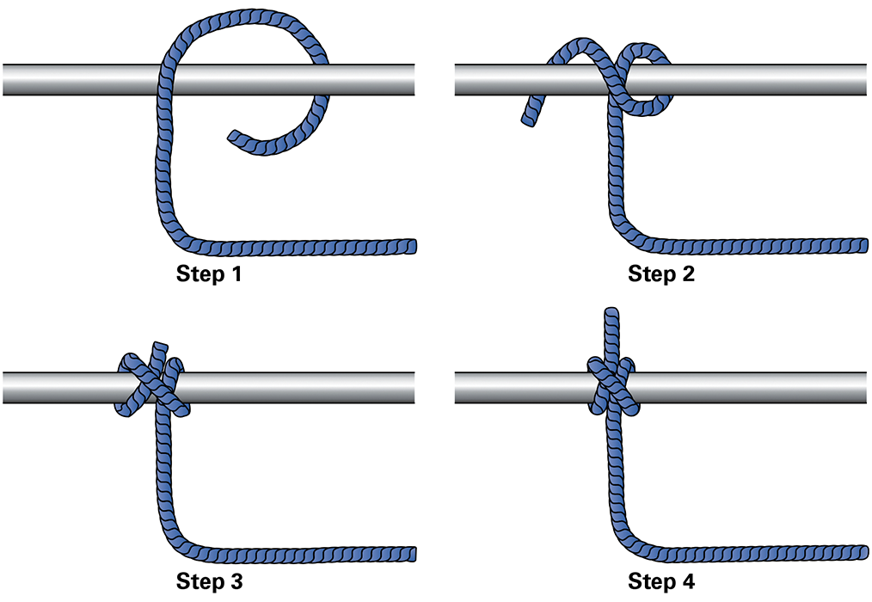
1.3.4 – The Clove Hitch (1 of 3)
Do not use this knot alone; use additional half hitches to make it more secure.
Threading the End Technique

Slide 21
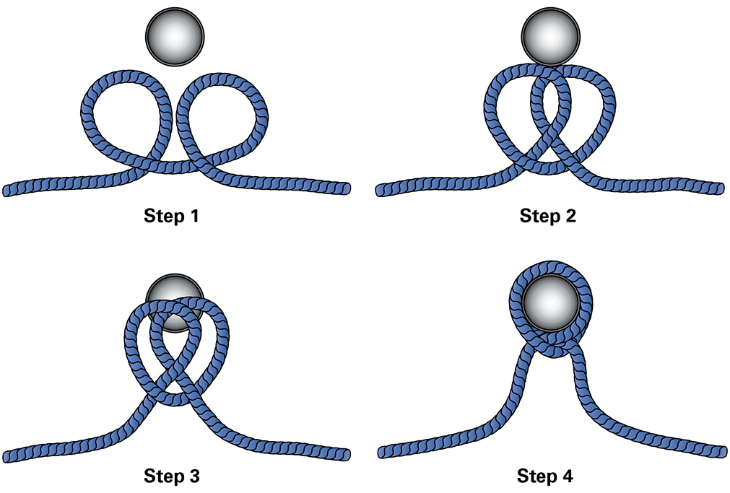
1.3.4 – The Clove Hitch (2 of 3)
Stacked Loops Technique

Slide 22
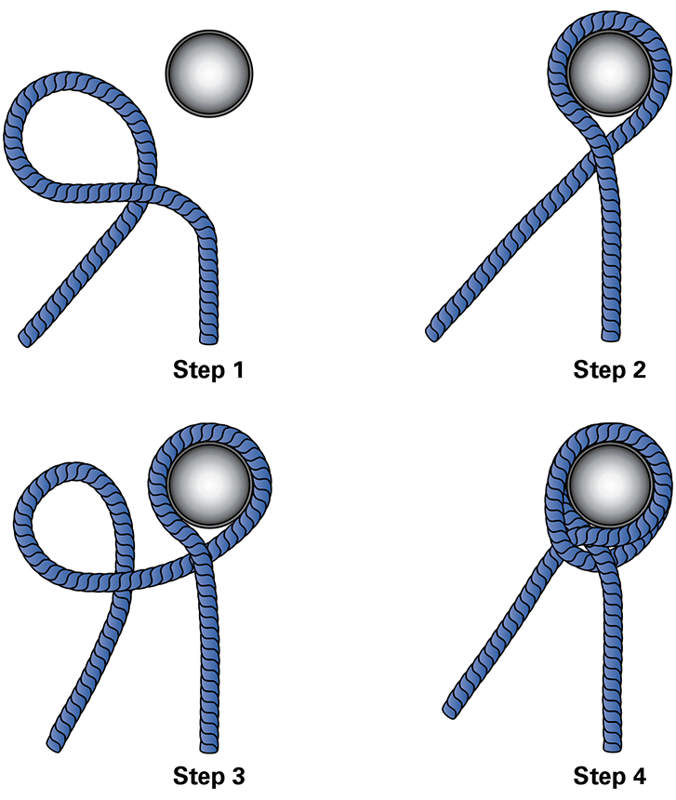
1.3.4 – The Clove Hitch (3 of 3)
Two Half Hitches Technique

Slide 23
1.0.0 Section Review Question One
True
Loose clothing is best to wear when handling material.
False

Slide 24
1.0.0 Section Review Question One Answer
True
Loose clothing is best to wear when handling material.
False

Slide 25
1.0.0 Section Review Question Two
bend your knees
All of these are proper lifting technique except ________.
lift with your legs
keep you back straight
keep your head down

Slide 26
1.0.0 Section Review Question Two Answer
bend your knees
All of these are proper lifting technique except ________.
lift with your legs
keep you back straight
keep your head down

Slide 27
1.0.0 Section Review Question Three
True
Only store materials and equipment when they will not be in use for a week or more.
False

Slide 28
1.0.0 Section Review Question Three Answer
True
Only store materials and equipment when they will not be in use for a week or more.
False

Slide 29
1.0.0 Section Review Question Four
bow knot
A knot used to form a loop that neither slips nor jams is called a ________.
clove hitch
bowline
square knot

Slide 30
1.0.0 Section Review Question Four Answer
bow knot
A knot used to form a loop that neither slips nor jams is called a ________.
clove hitch
bowline
square knot

Slide 31
1.0.0 Section Review Question Five
8 feet
Ask a co-worker for assistance when an object is longer than ________.
10 feet
12 feet
15 feet

Slide 32
1.0.0 Section Review Question Five Answer
8 feet
Ask a co-worker for assistance when an object is longer than ________.
10 feet
12 feet
15 feet

Slide 33
Next Section…
2.0.0 Material Handling Equipment
Read Sections 2.0.0 through 2.2.6. Complete the Section 2.0.0 Section Review.

