Slide 2
Session 2: Identifying Drawing Elements; Dimensions and Drawing Scales; Using Scales

Slide 3
Session Two Objectives
When trainees have completed this session, they should be able to do the following:
Identify and describe various types of construction drawings, including their fundamental components and features.
  Identify and explain the significance of various drawing elements, such as lines of construction, symbols, and grid lines.
  Identify and explain the use of dimensions and various drawing scales.
  Identify and describe how to use engineer’s and architect’s scales.

Slide 4
Session Two Performance Task
Using the floor plan supplied with this module:
Locate the wall common to both interview rooms.
Determine the overall width of the structure studio.
Determine the distance from the outside east wall to the center of the beam in the structure studio.
Determine the elevation of the slab.

Slide 5
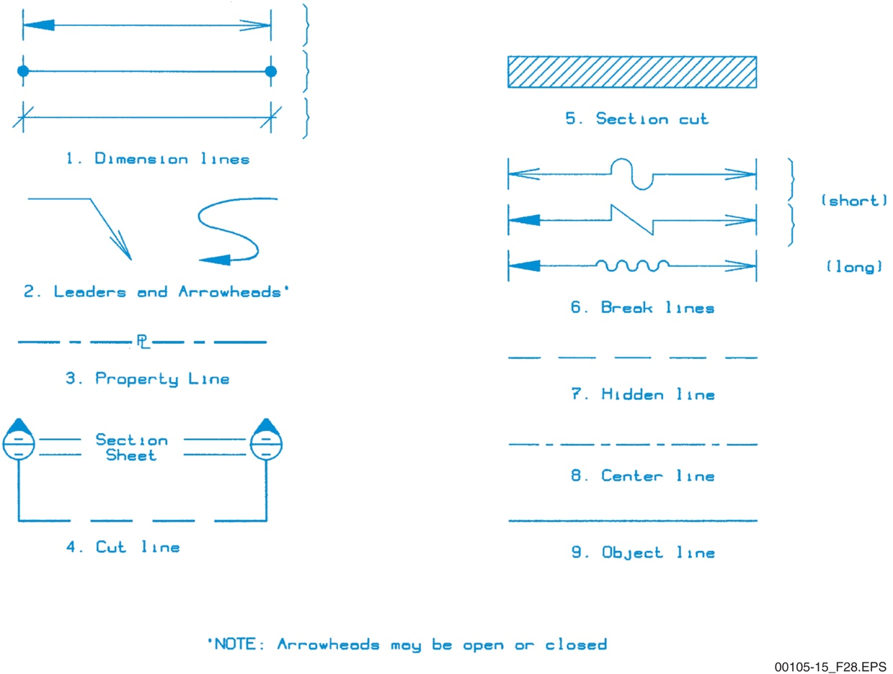
Sections 1.3.1 and 1.3.2 – Lines
This legend is sometimes referred to as the alphabet of lines. Line style can provide a lot of information to the user.
Notes:
Use the figure to identify the various types of drawing lines and their meaning.

Slide 6
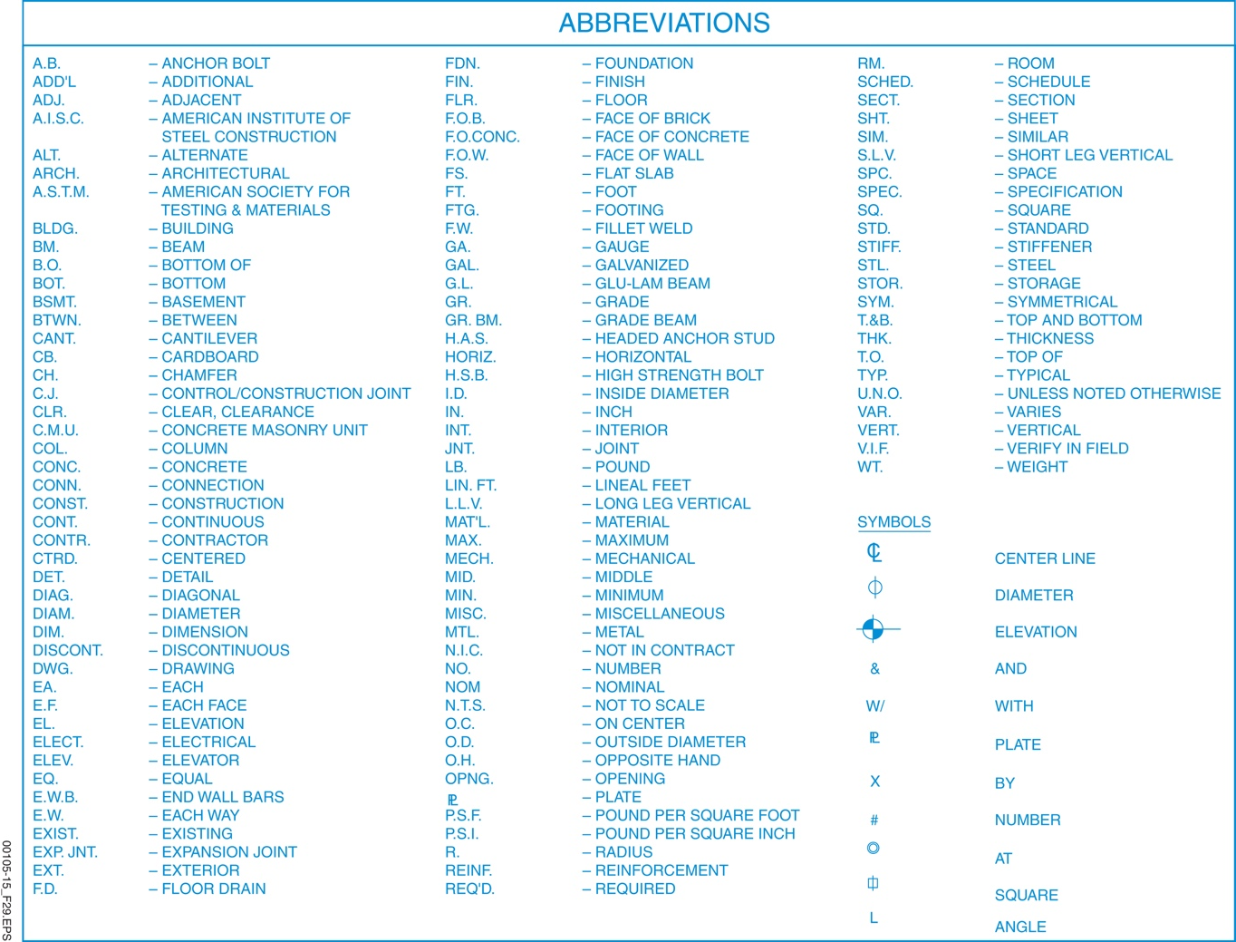
Sections 1.3.1 and 1.3.2 – Lines
Abbreviations are necessary due to the limited space available on drawings. Note that capital letters are always used.
Notes:
Use the figure to identify the various types of drawing lines and their meaning. Discuss the need for abbreviations and symbols on a drawing.

Slide 7
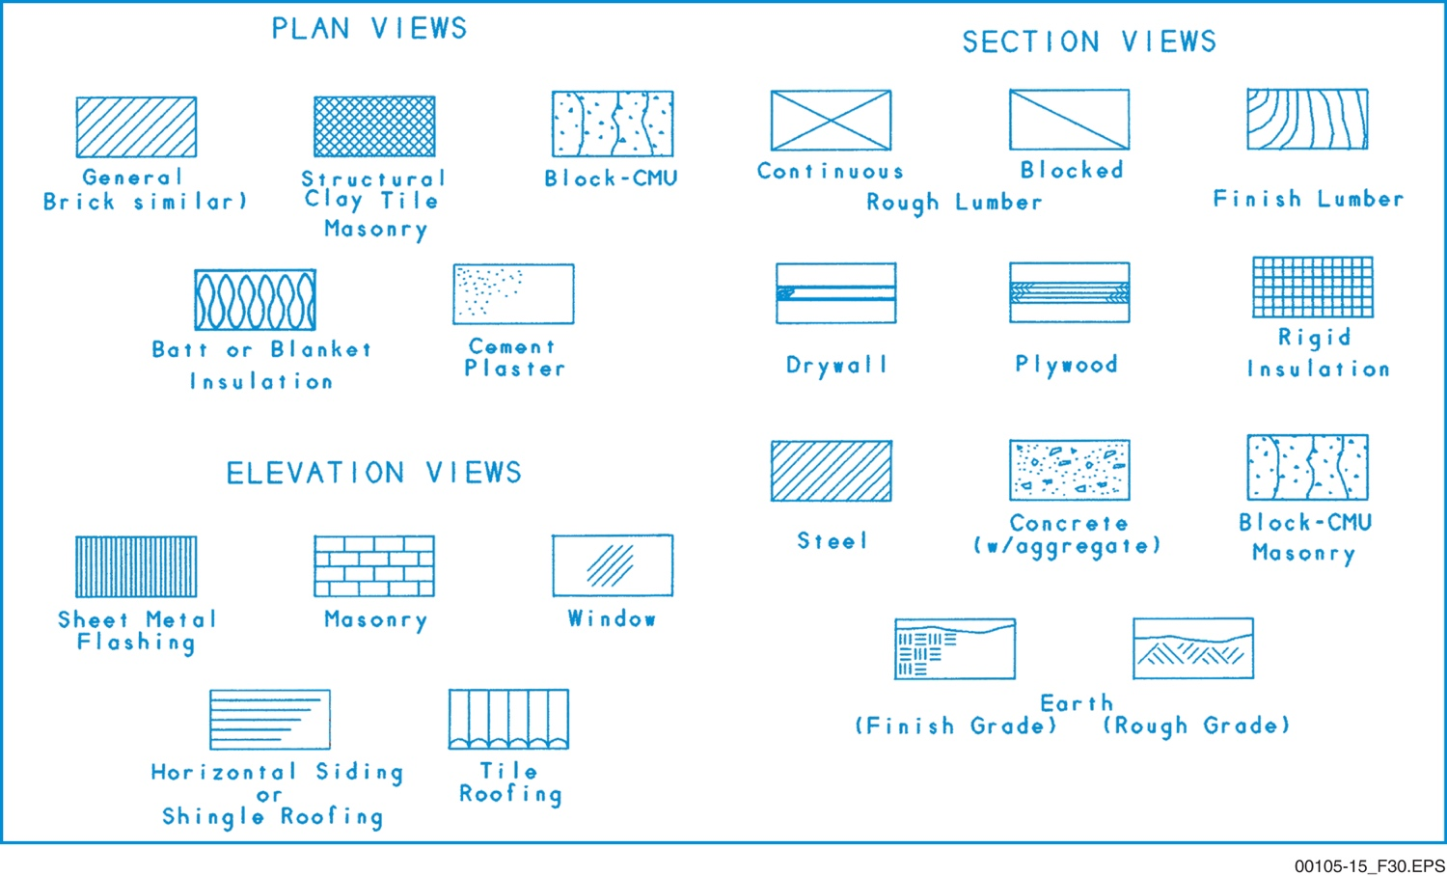
Section 1.3.2 – Symbols
There are literally thousands of possible symbols that can be
found on drawings. Although some symbols are common to
more than one craft, many are unique to a particular craft.
Use the legend; do not assume they will always mean the same thing!
Notes:
Emphasize that each trade has its own symbols. Ask the trainees why it is important to understand the symbols used by other trades. Review common symbols used on various drawing types.

Slide 8
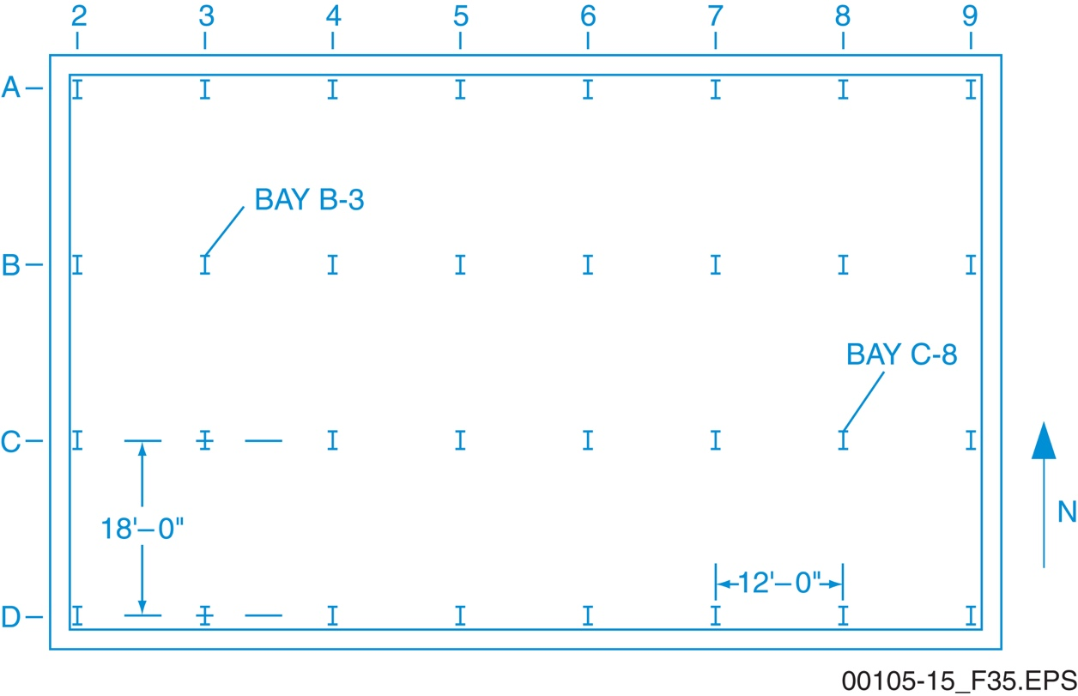
Section 1.3.3 – Gridlines
Gridlines on drawings are used in the same way they are used
on a common map—to refer to a specific location or area.
Gridlines are generally created by the alignment of supporting columns, as shown here.
Notes:
Explain how drawing gridlines are used in the same manner as those found on larger maps. Point out why certain numbers and letters are omitted.

Slide 9
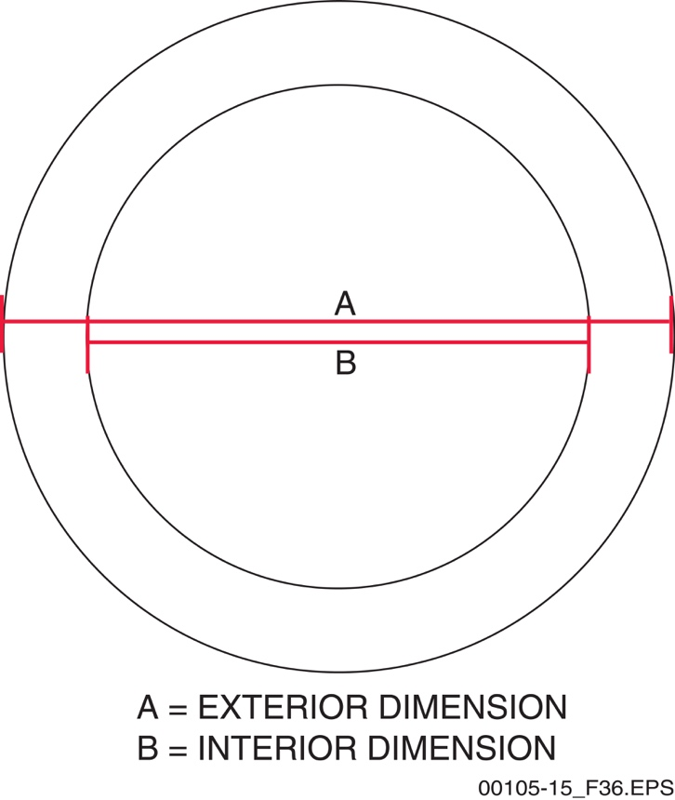
Section 1.4.1 – Dimensions
Always take great care when making measurements, and be certain that you are measuring to the correct point. This can be challenging when the drawings have been reduced in size.
Notes:
Describe how dimensions are generally shown on a drawing. Use the figure to show how two dimensions can easily be misunderstood. Stress the importance of accurate measurements.

Slide 10
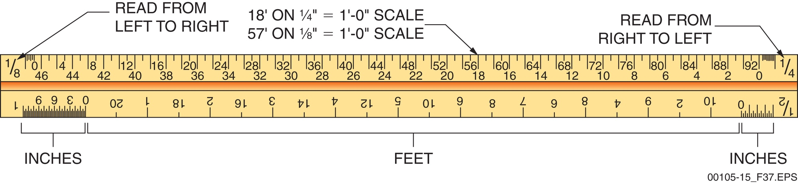
Section 1.5.1 – Architect’s Scale
Triangular scales, or tri-scales, are the most popular since they
reduce the number of scales that need to be available.
Drawing scales often differ from page-to-page in the same set
of plans; having one scale instead six is far more convenient.
Notes:
Describe the use of an architect's scale. Discuss the measurements depicted on the scale.

Slide 11
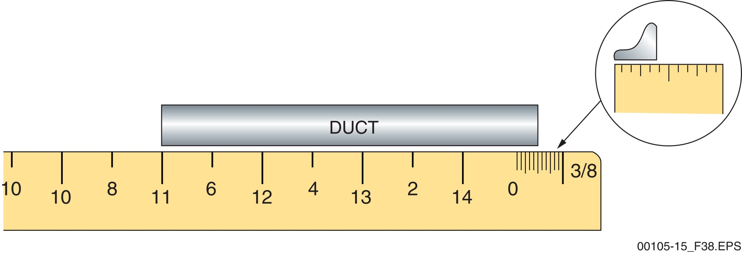
Section 1.5.1 – Architect’s Scale
As shown here, an architect’s scale for inches and feet
breaks the scale increment value, such as 3/8",
into twelve equal parts to represent inches.
Notes:
Explain how to read an architect's scale.

Slide 12
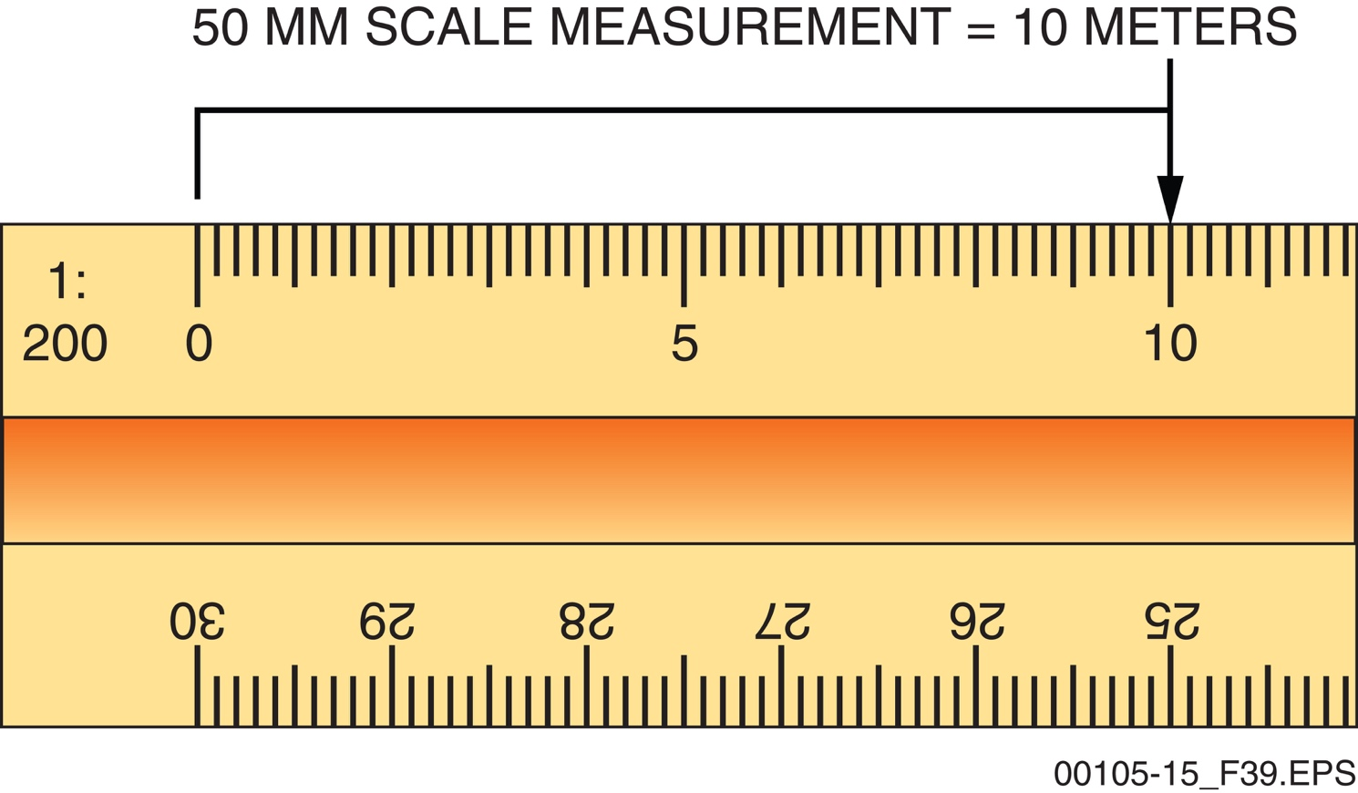
Section 1.5.2 – Metric Scales
Metric scales are always calibrated in units of 10—
the basis for the metric system.
Notes:
Discuss how metric architect's scales are calibrated. Explain how it is determined whether the millimeter or meter is used and when kilometers are used. Explain how to properly use the metric architect's scale.

Slide 13
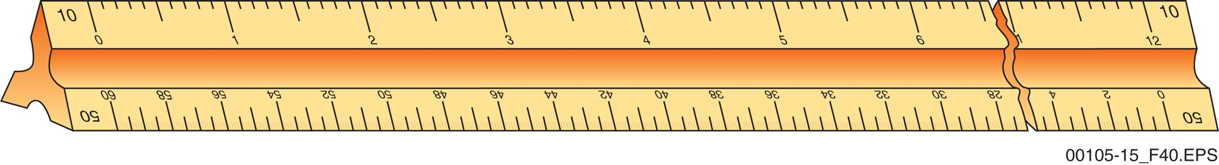
Section 1.5.2 – Engineer’s Scales
Since it can accommodate large measurements, the engineer’s scale is often used on civil drawings. It is also broken into multiples of 10, like a metric scale.
Notes:
Discuss the uses of an engineer's scale. Discuss how the scale is set up for measurements in comparison to the architect's scale. Explain how to read and use the engineer's scale.

Slide 14
Wrap Up – Trade Terms
Architect
A qualified, licensed person who creates and designs drawings for a construction project.
Architect’s scale
A specialized ruler used in making or measuring reduced scale drawings. The ruler is marked with a range of calibrated ratios for laying out distances, with scales indicating feet, inches, and fractions of inches. Used on drawings other than site plans.
Dimension line
A line on a drawing with a measurement indicating length.
Notes:
Review the Trade Terms introduced in this session to verify that the trainees are familiar with the terms. Have the trainees define the term, and then click to have the definitions appear, one at a time.

Slide 15
Wrap Up – Trade Terms
Engineer
A person who applies scientific principles in design and construction.
Engineer’s scale
A straightedge measuring device divided uniformly into multiples of 10 divisions per inch so that drawings can be made with decimal values. Used mainly for land measurements on site plans.
Hidden line
A dashed line showing an object obstructed from view by another object.
Notes:
Review the Trade Terms introduced in this session to verify that the trainees are familiar with the terms. Have the trainees define the term, and then click to have the definitions appear, one at a time.

Slide 16
Wrap Up – Trade Terms
Leader
In drafting, the line on which an arrowhead is placed and used to identify a component.
Metric scale
A straightedge measuring device divided into centimeters, with each centimeter divided into 10 millimeters. Usually used for architectural drawings and sometimes referred to as a metric architect’s scale.
Not to scale (NTS)
Describes drawings that show relative positions and sizes only, without scale.
Notes:
Review the Trade Terms introduced in this session to verify that the trainees are familiar with the terms. Have the trainees define the term, and then click to have the definitions appear, one at a time.

Slide 17
Next Session…
LABORATORY:
READING CONSTRUCTION DRAWINGS
Review the complete module to prepare for the upcoming laboratory and practice session.

